Slide 2
CONGRATULATIONS!
The past several years, PBIS has been an important system that has helped improve our school climate, decrease our ODR, and has …
Teachers are recognizing positive student behavior with scratcher tickets
Teachers are recognizing each other’s positive actions with “Kind” notes and cups of coffee
Students are getting involved with “Be Kind Step Up” activities.
The school received an award at the

Slide 3
CONGRATULATIONS!
We are a “BE Kind” campus
Students who need additional support are encouraged to join a SAP group (Students Assistance Group)
100+ In coming Freshman attended BOOST
Drug Awareness Campaign

Slide 4
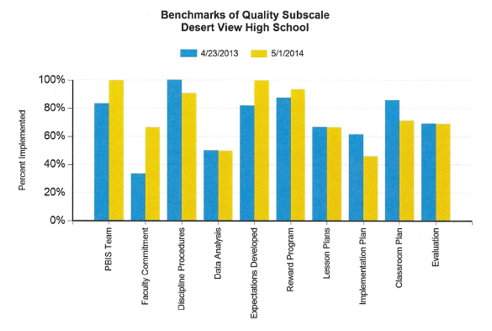
Thank You!
Notes:
The BOQ allows teams to self-assess and use the results to update the school’s PBIS action plan. This year we received the ______ Award for hitting the 80% goal.

Slide 5
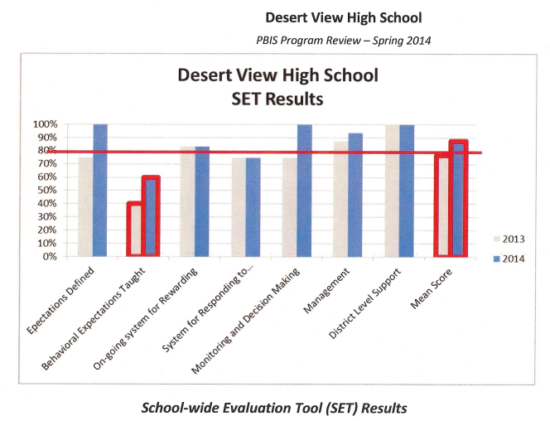
Thank You!
Notes:
School-wide Evaluation Tool. The SET produces a summary score and a subscale for each of the seven features areas of school-wide PBIS. It is a general index of school implementation. Our goal was 80%, and again we hit it in several areas.

Slide 6
What is PBIS?
PBIS is a system and is not a program or curriculum
PBIS is school-wide, evidence-based, and is used nationwide
PBIS catches students displaying proper behavior and provides consistent consequences for disruptive behavior
PBIS teaches and supports students so they can be socially and behaviorally successful
PBIS makes schools more predictable, consistent, positive, and safe for all staff and students

Slide 7
These supports include…
Proactive strategies for defining, teaching, and supporting appropriate student behaviors to create positive school environments.
A continuum of positive behavior support for all students is implemented in areas including the classroom and non-classroom settings (such as hallways, busses and bathrooms).

Slide 8
What are the outcomes of PBIS?
Decreased classroom disruptions and office discipline referrals
Increased academic achievement and performance
Improved school climate and safety

Slide 9
Why is PBIS needed?
School office referral data often shows that quite a few students are being sent to the office for preventable disruptions in the classroom
When that happens, they are not learning and this also interferes with the learning of others
We need to help ALL students to be successful academically and behaviorally.

Slide 10
Reinforcement Ticket
Students should receive a ticket and verbal reinforcement from staff when they demonstrate one of the skills on our school’s Expectation Matrix
The ticket can then be used to access intermediate and long term reinforcement opportunities
Notes:
The past two years we used the DV Scratcher cards…

Slide 11
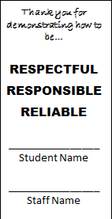
No more scratcher cards…The new improved “PAWSITIVE” Ticket

Slide 12
3-Second/3-Step Reinforcement System
State the Expectation:
“Thank you for being responsible…”
State the skill:
“…by having your laptop open on the LEARN page.”
Give the “PAWSITIVE” card!

Slide 13
Rule of thumb
Every student in school should receive at least 2 PAWSITIVE cards/week
If each staff members hands out 10 PAWSITIVE cards per day (2 per hour), we will easily meet our goal for the week
This only adds up if ALL staff use the PAWSITIVE cards regularly!

Slide 14
Go Forth and “PAWSITIVELY” Reinforce our staff and students using the three-step process…
State the Expectation:
“Thank you for being respectful…”
State the Skill:
“…by waiting to be called on”
Hand them a PAWSITIVE card!
Be sure to write your name on it

