Slide 1
Measurement and Data Notes
Ms. Wiltshire’s class
3rd grade

Slide 2
Telling time
How many minutes are in an hour? - 60 minutes.
How many seconds are in a minute?- 60 seconds.
What are the two different types of clocks? - Digital and analog
What hand is the minute hand?- The long hand.
What hand is the hour hand?- The short hand.

Slide 3
Telling time continued
What does ‘a quarter past’ mean?- It means that it is 15 minutes past the hour!
What does ‘a quarter till’ mean? - It means that it is 15 minutes till the next hour!
What does ‘half past’ mean?- It is 30 minutes past the hour. So 12:30, for example.

Slide 4
Other forms of measurement
16 ounces in 1 pound
1,000 milliliters in 1 liter (used to measure liquids).
1,000 grams in 1 kilogram (used for weight or mass of items).
Ounces and grams are less than (smaller than) pounds
Grams are less than (smaller than) kilograms
Milliliters are less than ( smaller than) liters

Slide 5
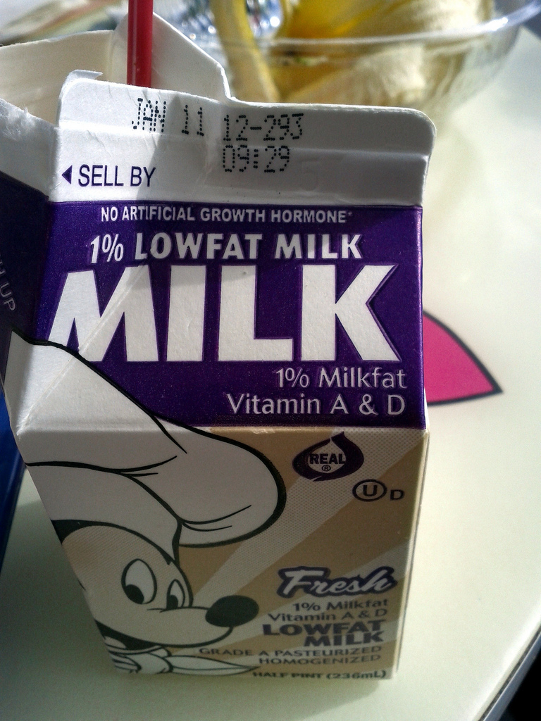
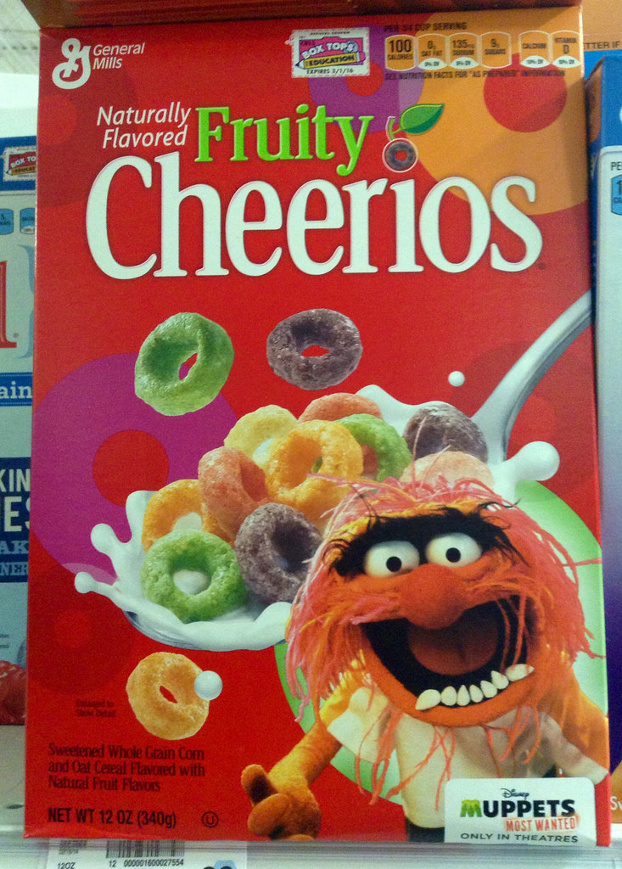
Examples of the measurements
Items measured with Grams
Food, bread, pasta, cereal, etc.
Items measured with milliliters
Toothpaste, medicines, small milk cartons (from cafeteria)

