Slide 1
4th Grade Guidance Lesson

Slide 2
Bullying is unwanted, aggressive behavior among school aged children that involves a real or perceived power imbalance. The behavior is repeated, or has the potential to be repeated, over time. Both kids who are bullied and who bully others may have serious, lasting problems.
Resource: www.stopbullying.gov

Slide 3
Facts:
Bullying is repeated. It happens more than once.
Bullying creates an “imbalance of power”, meaning the victim often feels powerless to the bully.
Bullying is not tolerated in schools and needs to be reported.

Slide 4
Types of Bullying
Physical: When bullying occurs physically through hitting, kicking, pushing, shoving or any other manner that can physically hurt someone.
Verbal: Bullying that involved harsh or aggressive words that may be insulting or even threatening.
Cyber: When bullying occurs online or through text messages.

Slide 5
Examples of bullying include:
Purposefully leaving someone out of a group.
Taunting
Threatening
Spreading rumors/ gossiping
Telling someone not to be friends with someone
Intentionally embarrassing someone

Slide 7
Discussion Questions:
What were the examples of bullying in this story?
Why do you think Pete was bullying others?
How did his classmates feel when they were being bullied?
What is a bystander?
How did Ralph not act as a bystander? Do you think Pete will bully others again?

Slide 8
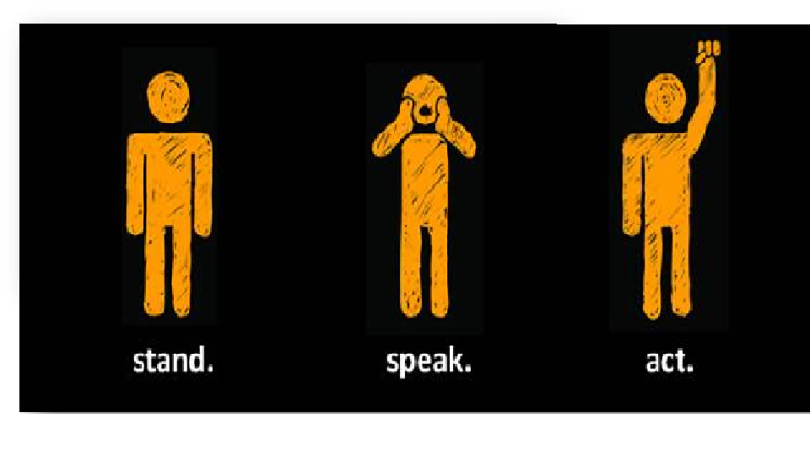
Bystanders are children who see bullying behavior happen but do nothing about it. Bystanders make up the largest population in schools. Experts say that bystanders have the power to reduce bullying in schools by speaking up.

Slide 9
What can you do as a bystander to stop bullying?

Slide 10
The Promise
I will speak up instead of acting as a bystander.
I choose to participate in activities that don’t involve teasing.
I forgive others if they make poor choices.
I model good behavior.
I accept others for their differences.
I include others in group situations.
I will talk to an adult when there is a problem I cannot manage on my own.
I am powerful in making difference in my school.

