Slide 1
Achievement
4th Grade Guidance Lesson

Slide 2
Review
What is a goal?
What are the goal-setting steps?
Why is goal setting important?
What are some qualities and characteristics that help us reach our goals?

Slide 3
Achievement is when you succeed at something or reach something that you have been working towards.

Slide 4
Wilma Unlimited by Kathleen Krull A story about how Wilma Rudolph became the world’s fastest woman.

Slide 5
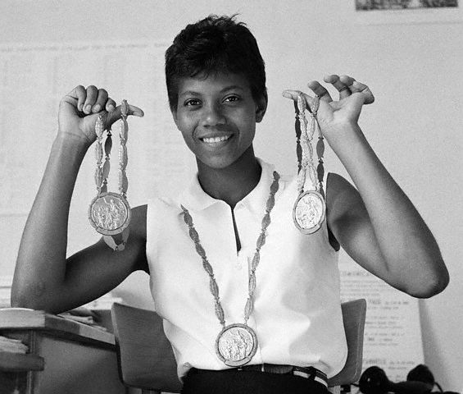
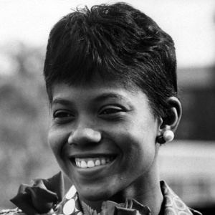
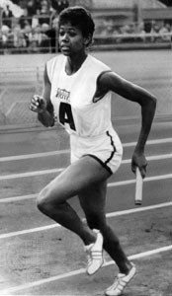
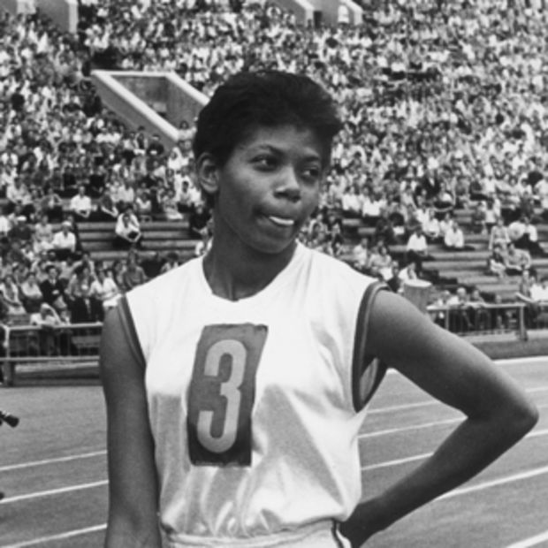
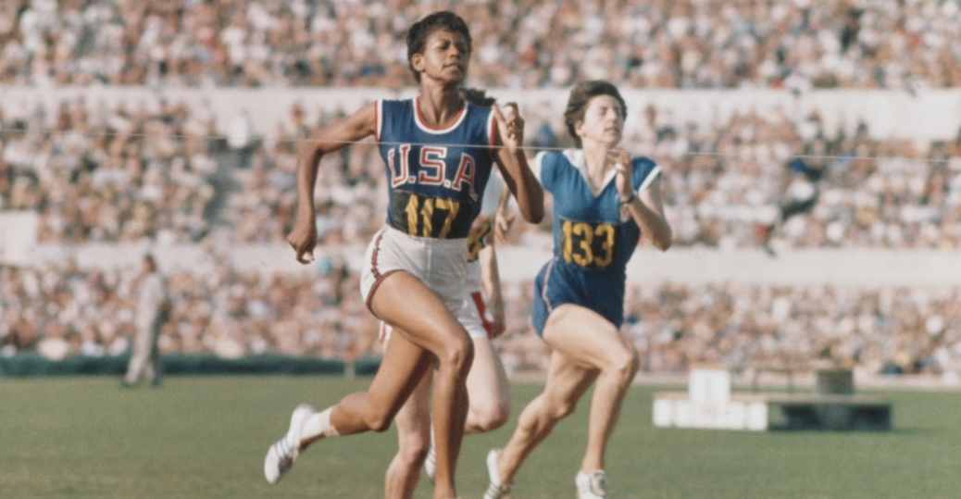

Slide 6
Achievement

Slide 7
