Slide 1

Kindness Month n
Sunnyside Unified School District
Crossing the Line: Appreciating Diversity

Slide 2
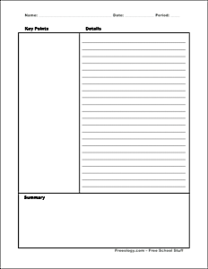
Cornell
Notes:

Slide 3
Essential ?
Can we value classmates, teachers, and staff who are different from ourselves in appearance, race, ethnicity, and personal history?

Slide 4
Diversity
(Define these terms in groups, be prepared to share.)
Appearance
Race
Ethnicity
Personal History

Slide 5
Diversity:
The quality or state of having many different forms, types, ideas, etc.
The state of having people who are different races or who have different cultures in a group or organization

Slide 6
What is your favorite food?

Slide 7
Activity
Crossing the line

Slide 8
Final thought…
Quickwrite:
Summarize this lesson, what you learned, and what you will take into your daily life from it?

