Slide 1
Kindness Month n Sunnyside Unified School District
Making Kinder Choices

Slide 2
Essential ?
Is it possible to make kind, responsible choices even in difficult or threatening situations?

Slide 3
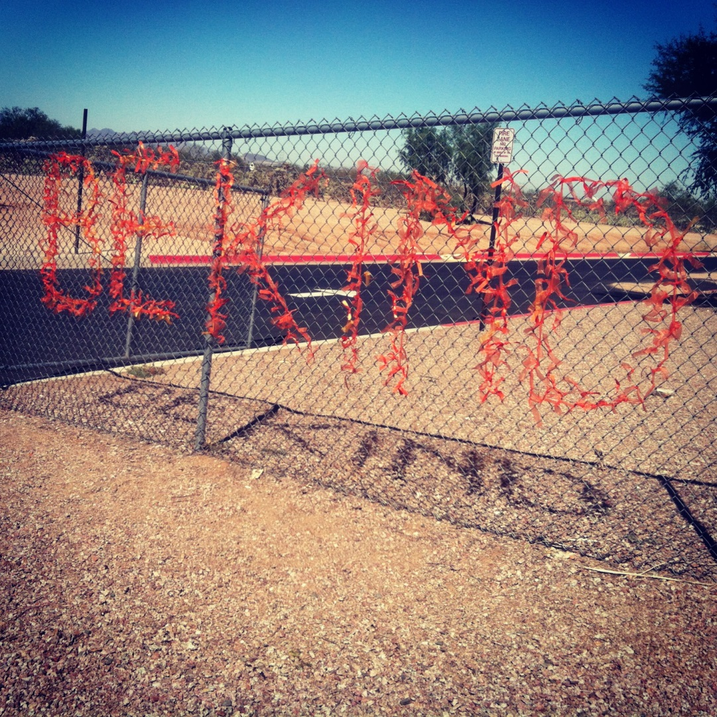
How are we doing? Is this a kind school?

Slide 4
Review
Bullying: A person is bullied when they’re harmed and harass in a
Deliberate (on purpose),
Repeated,
or hostile manner (intimidating & aggressive), that creates an imbalance of power

Slide 5
Why be kind?
Acts of kindness improve the functioning of the immune system, both the recipient, the person being kind, and even observers (Dyer).
Researchers found that altruism can spread by three degrees – from person to person to person to person (Fowler & Christakis).
People who provide social support to others have direct health benefits (John’s Hopkins University).
People who volunteer in their communities live longer (Konrath, et al.).

Slide 6
If kindness is a skill…
How do we teach it?

Slide 7
4 Corners
Four choices:
Ignore the situation or walk away
Intervene myself to stop or mediate the situation
Talk to the person in private
Seek help from an adult

Slide 8
Process ?s Let’s talk about : Did you respond differently in different scenarios & What influenced your decisions?
Who did you feel most comfortable confronting?
Who did you feel least comfortable confronting?
If you were not alone, would you feel more comfortable confronting a bully?
Who did you feel most comfortable defending?

Slide 9
The role of the bystander
How do you think the person being teased feels if people are listening, or watching, and don’t do anything?
How do you feel when you do nothing?

Slide 10
Be an Ally, not a Bystander!
An ally stands up for those being teased and bullied
Allies are practicing leadership
An ally helps new students, those in need
Allies makes this a kind campus!

Slide 11
Final thought…
Quickwrite:
Can you think of one person here at school that you know or have seen that needs an ally?
What could you do to help?

