Slide 1
Where do we see
ART?

Slide 2
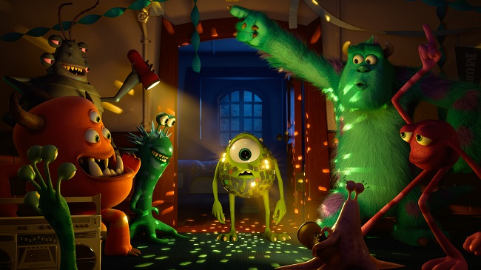
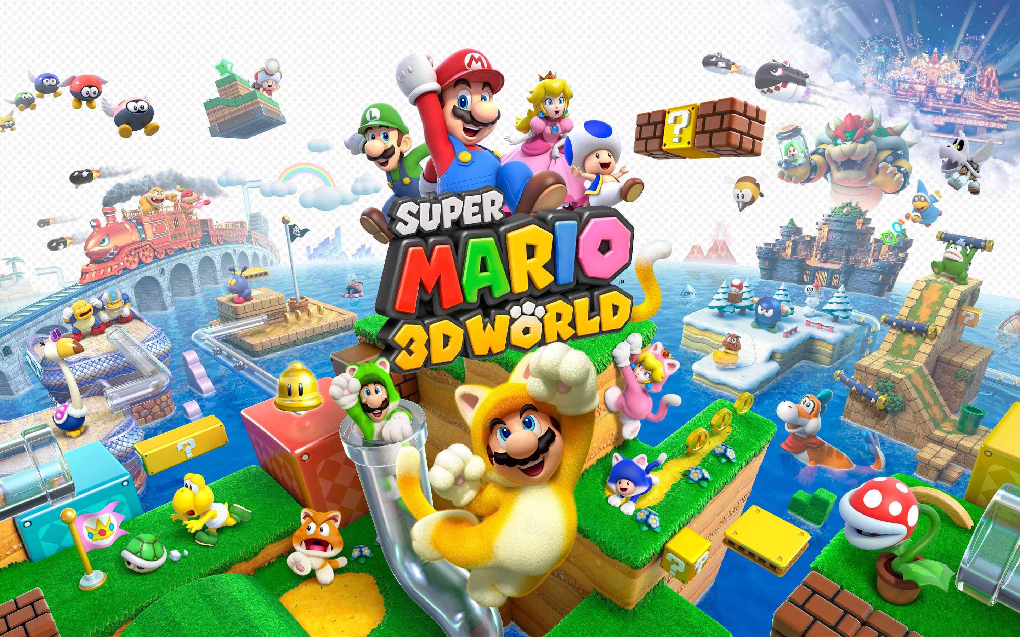
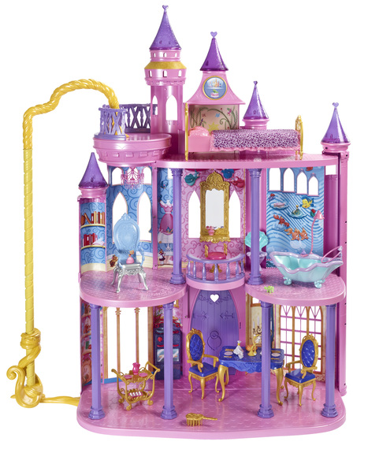
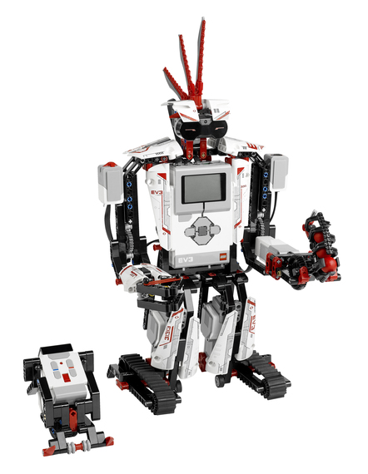
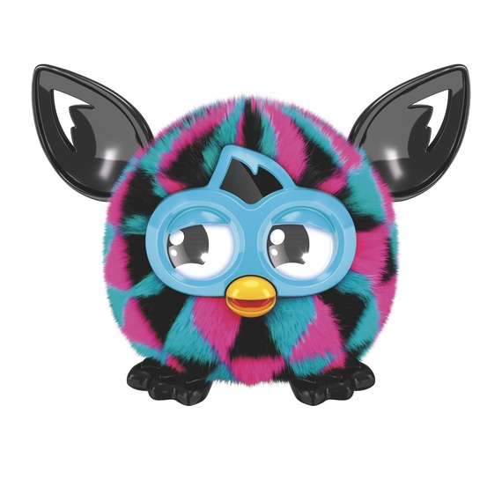
Art is all around us!
Artists create more than just paintings and sculptures.
Artists design the objects and images we commonly use and see everyday.
What do we do with art? What is its purpose?

Slide 3
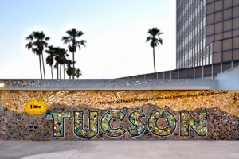
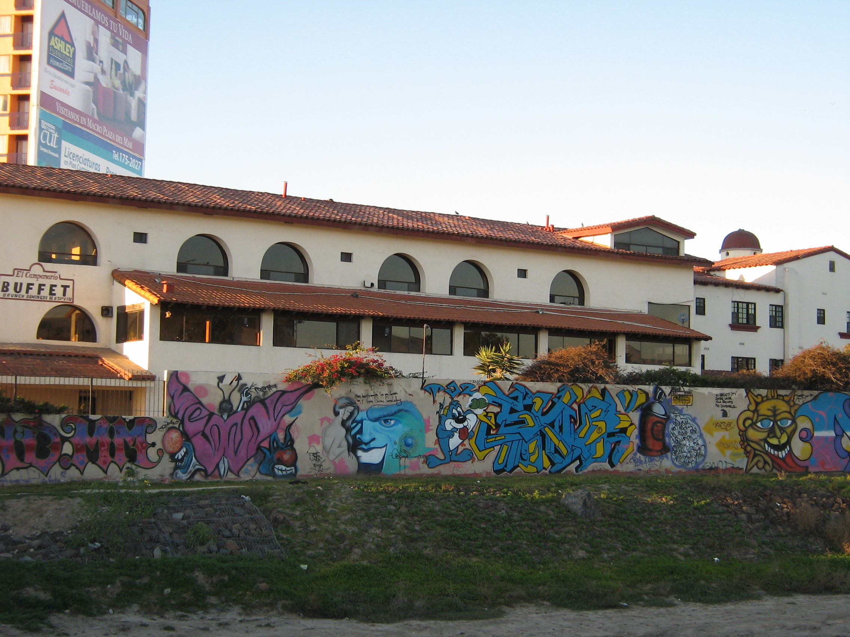
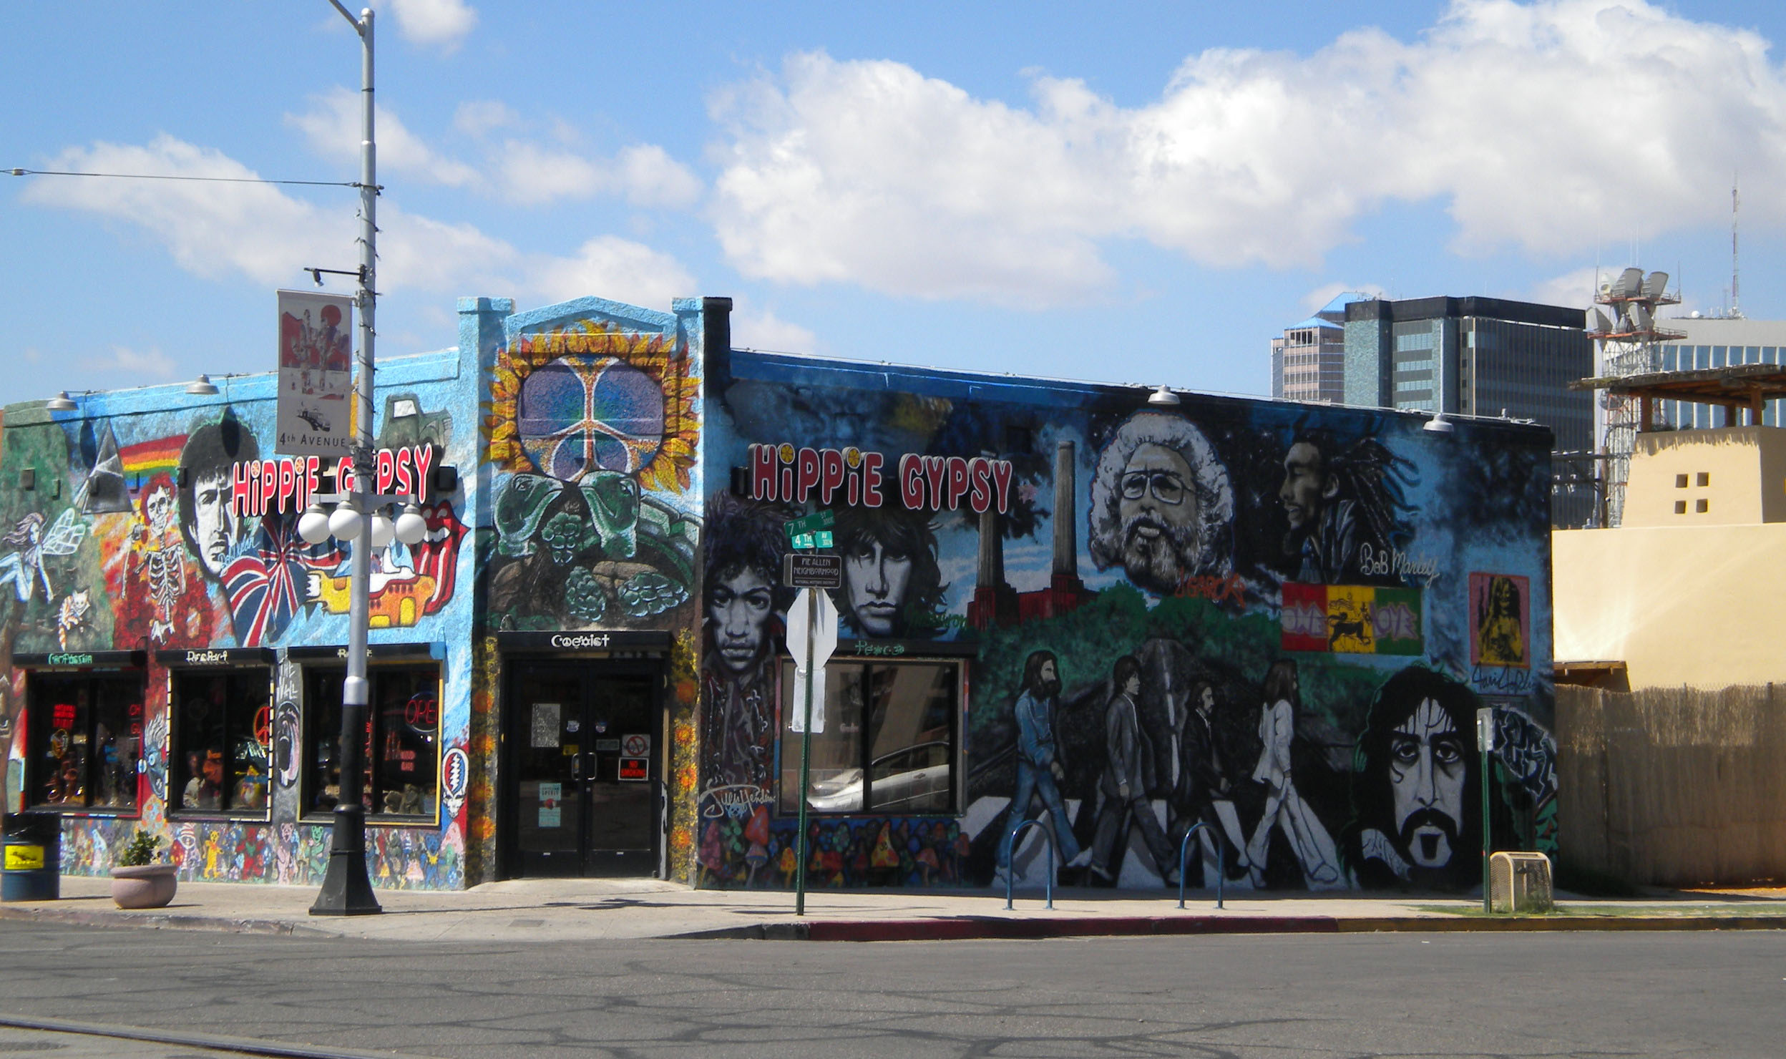
Art has many purposes.
For example,
art decorates our
environment.
We are lucky to have lots of art in Tucson!

Slide 4
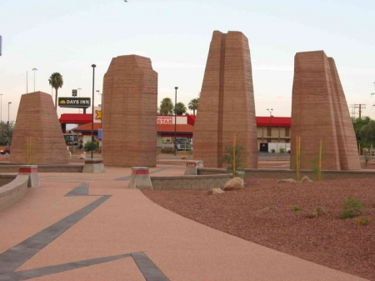
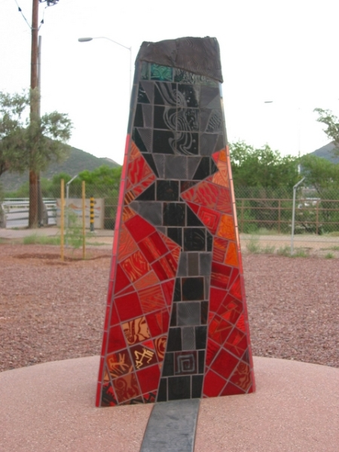
Art honors people and cultures.
“The site and its monumental forms create a presence of sentinels, testaments honoring the peoples living here in prehistoric times.”
-Judith Stewart, Joy Fox, Chuck Sternberg, Bob Vint, Andrew Rush, artists

Slide 5
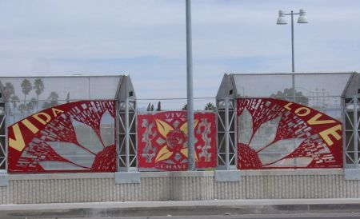
Viva Cesar Chavez
"Viva Cesar Chavez" is a celebration of the great labor leader and peace activist's life and legacy. It is meant to inspire others and to give the people of Tucson a place to enjoy the meaningful spirit of Cesar's life-work.” -Joshua Sarantitus and Alex Garza, artists

Slide 6
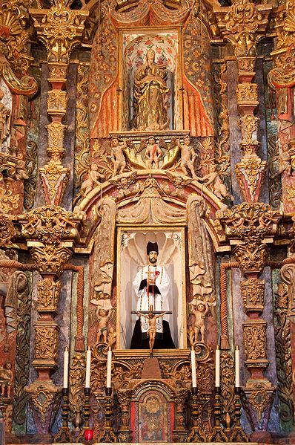
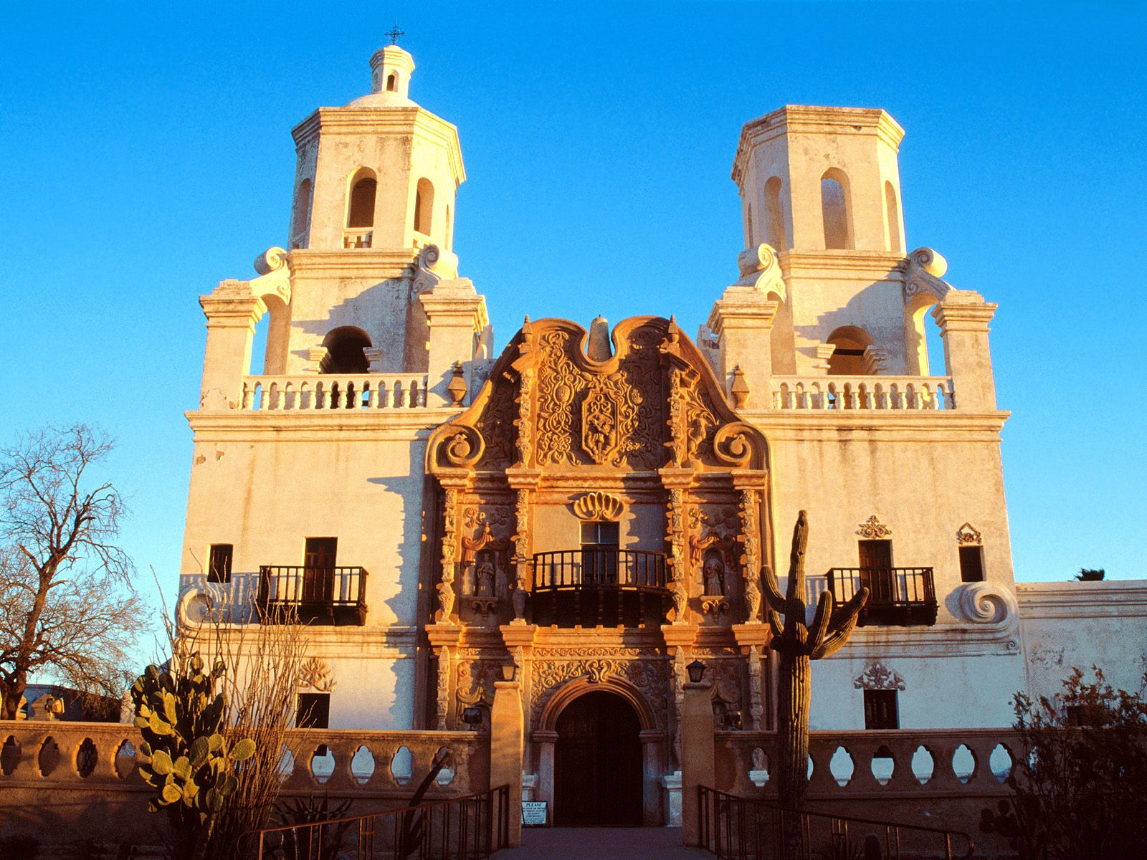
Artwork found inside the San Xavier del Bac Mission serves a historical and spiritual purpose; it honors the lives of significant religious figures in the Roman Catholic church. The building itself is a piece of art.

Slide 7
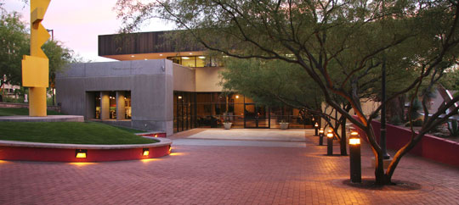
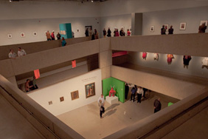
Typically we think of art as objects or images made by hand. These are often kept in galleries or museums. Why do you think art is kept in a special building?
Tucson Museum of Art

Slide 8
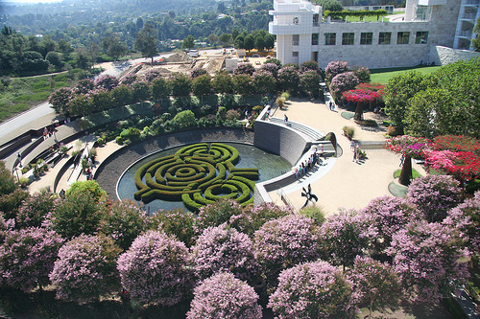
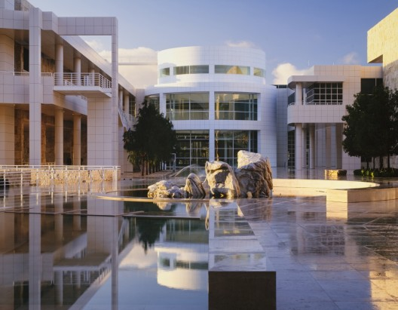
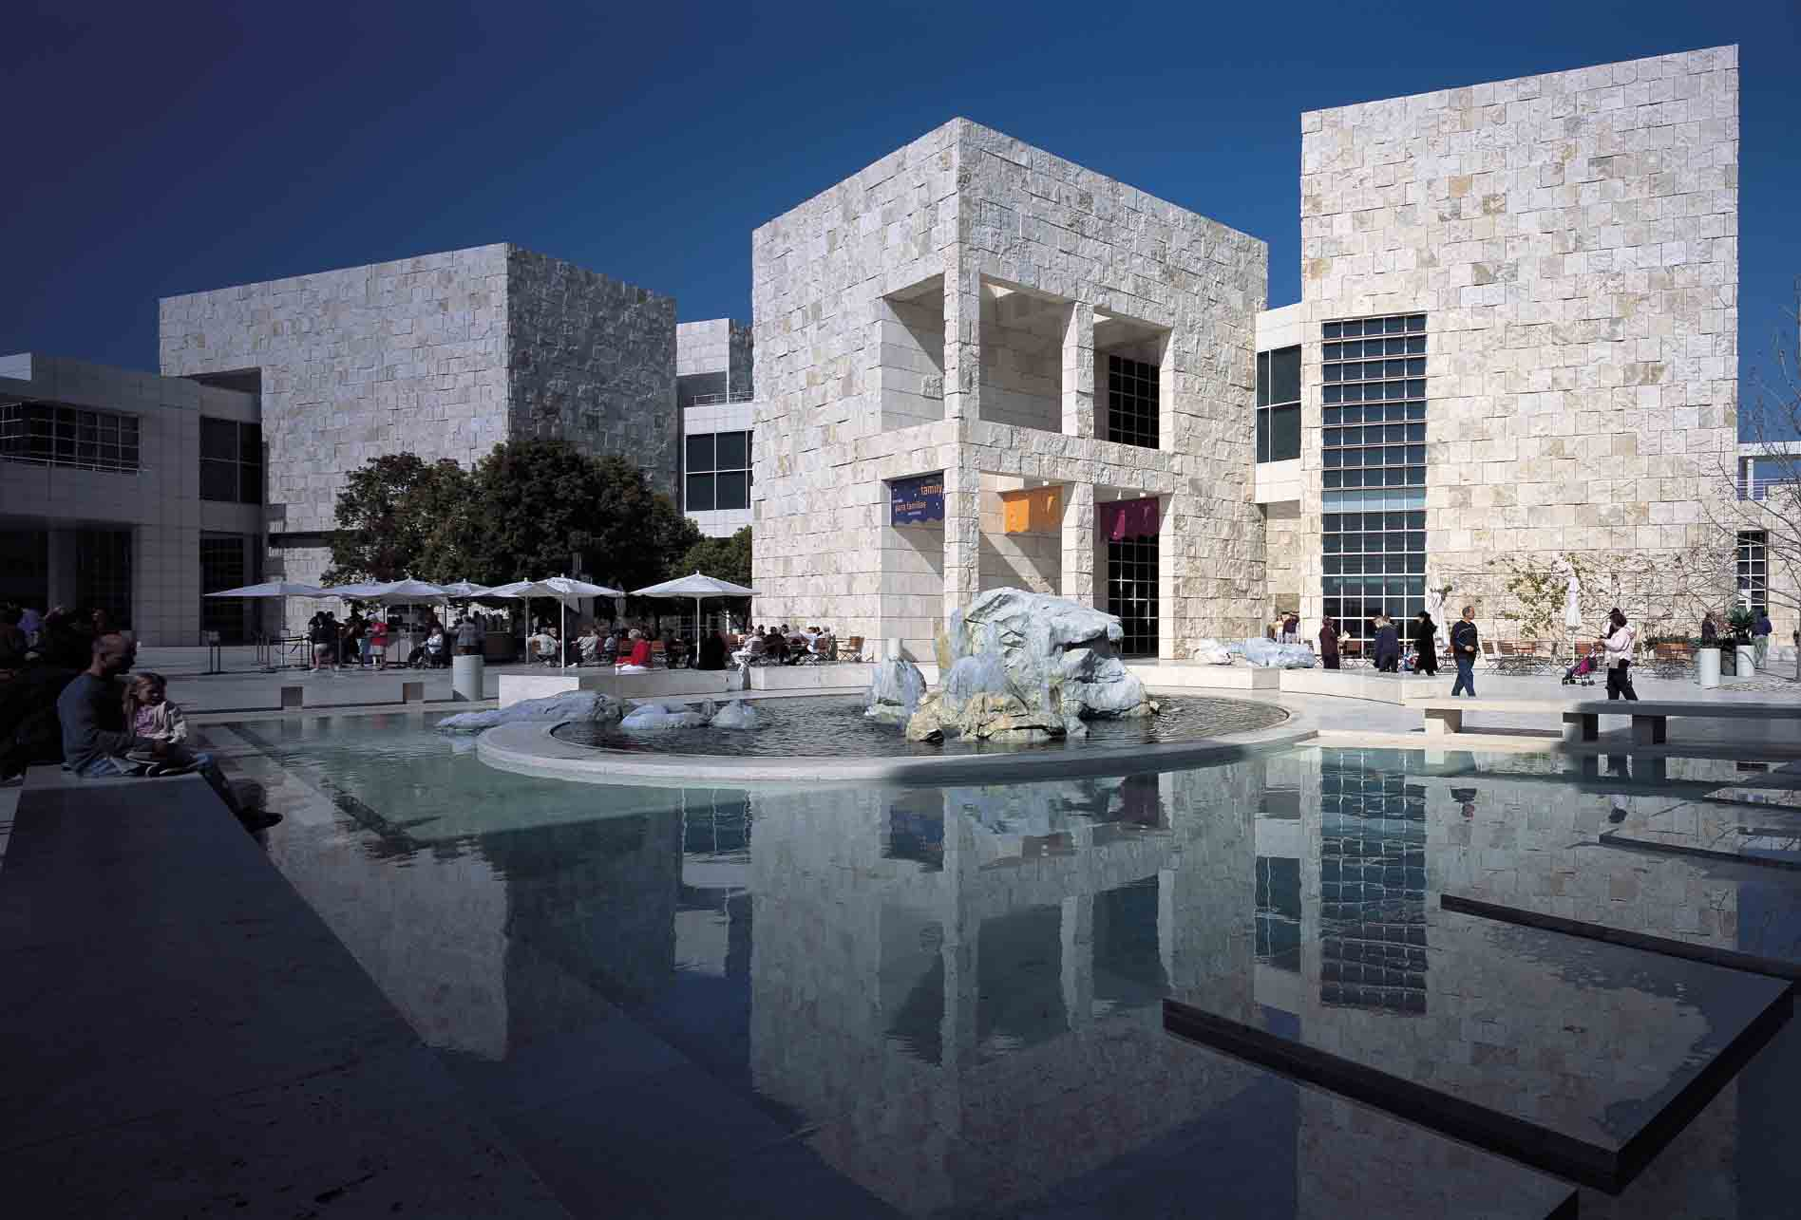
Art museums not only provide a space for us to look at artwork, but the buildings themselves are often imaginative and beautiful.
The Getty Center, Los Angeles California

Slide 9
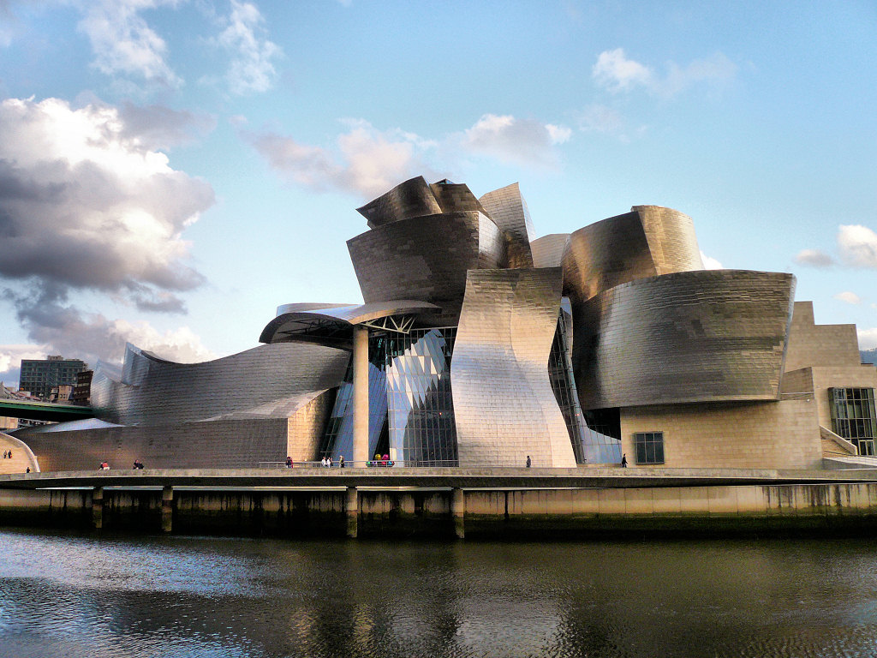
The Guggenhein Museum, Bilbao, Spain

Slide 10
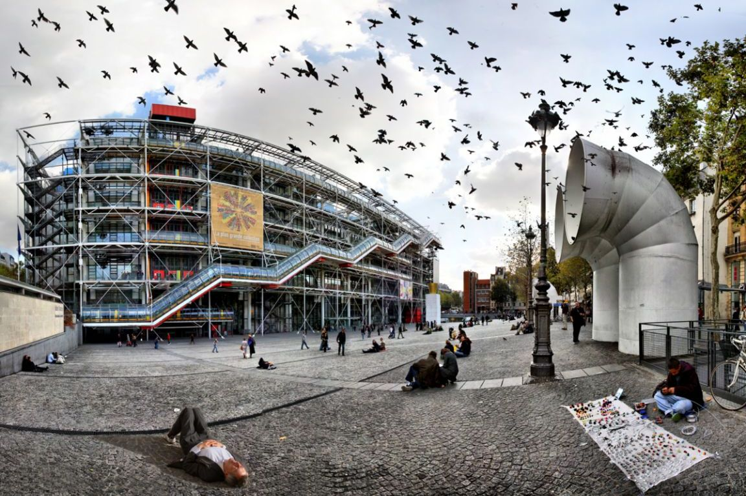
The Centre Pompidou, Paris, France

Slide 11
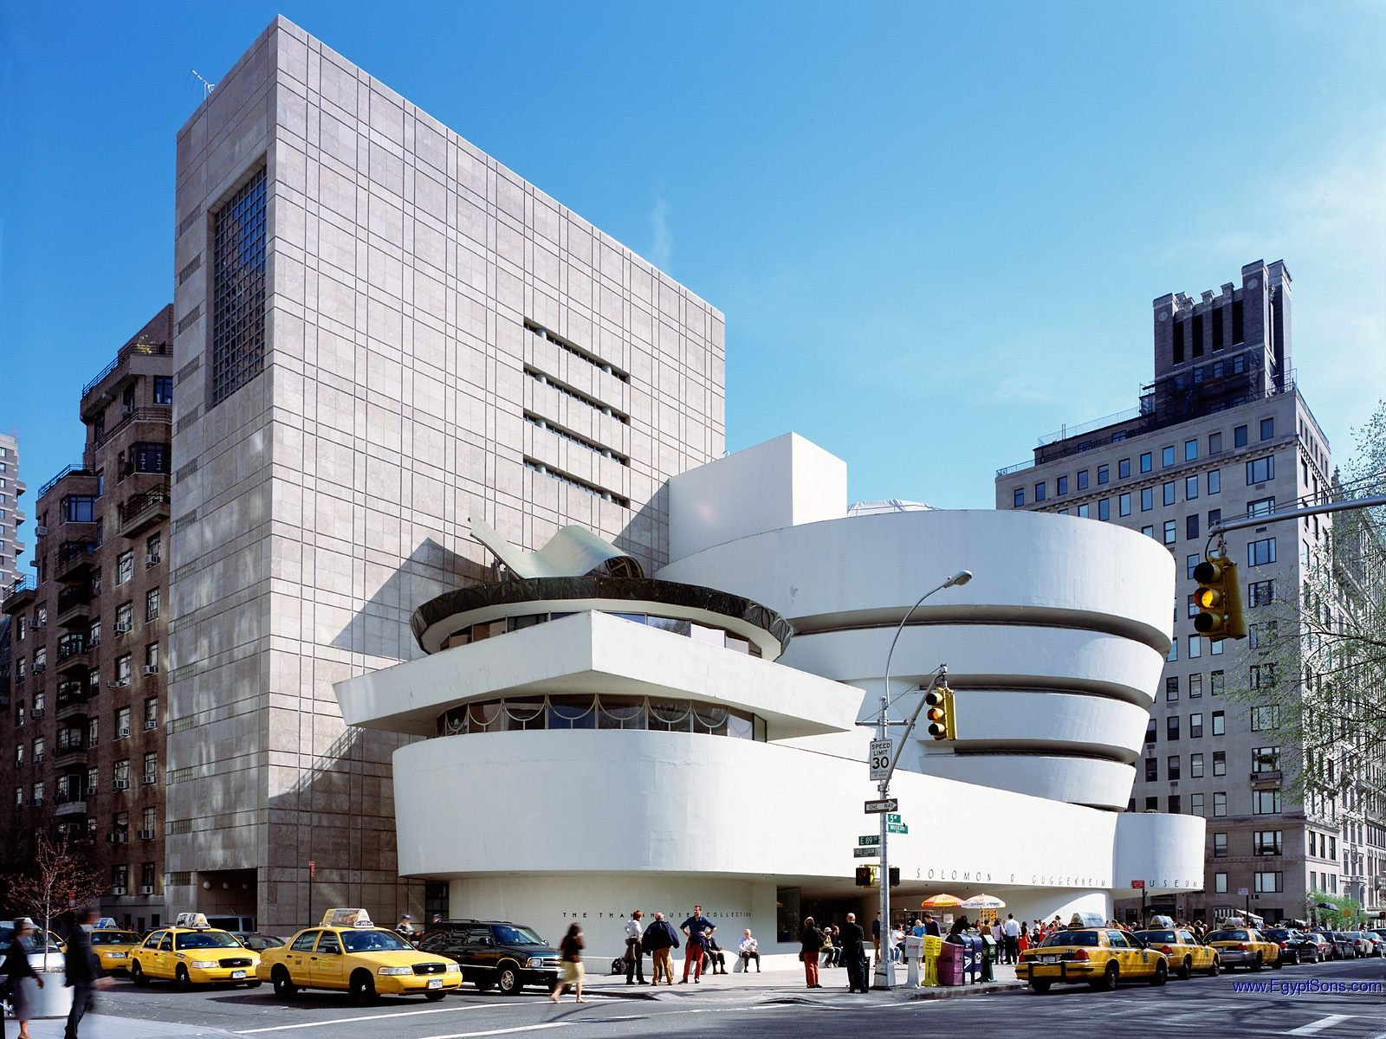
The Guggenhein Museum, New York City

Slide 12
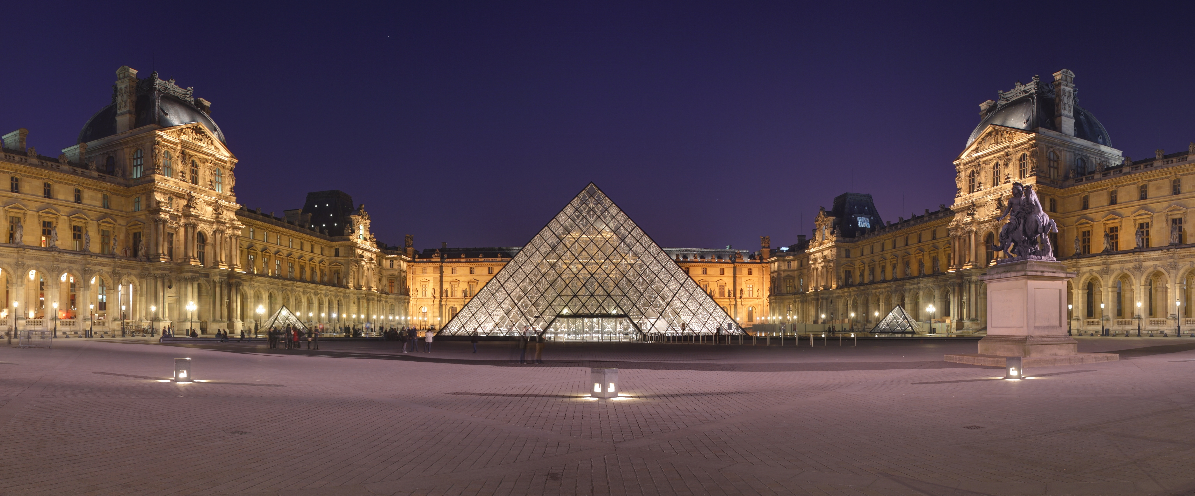
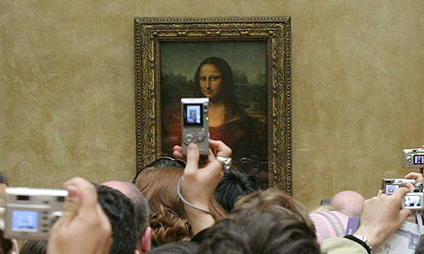
The Louvre, Paris, France

Slide 13
Each of these structures is a piece of art.
Which one do you like the best?
Explain why you like it.

