Slide 1
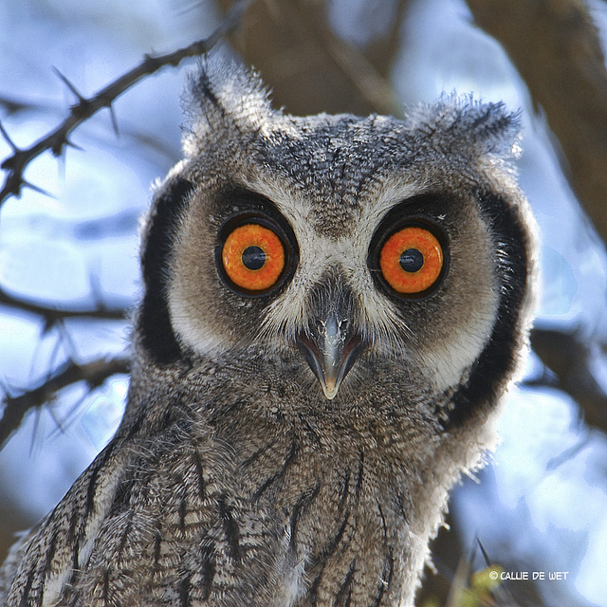
OBJECTIVE:
I will gain a broader perspective
(increase my understanding by opening my eyes and mind)
of what ART IS!
I will do this by reflecting on my personal opinion and by respectfully listening to others.

Slide 2
Think quietly to yourself.. What does the word “ART” mean? 1. How do you define it? 2. Where do we see it? 3. What is its purpose? 4. Why do people make art?

Slide 3
This book presents how one person defines art. Please look closely at each picture, listen carefully to the words we read, and think quietly about what it means to you.

Slide 6
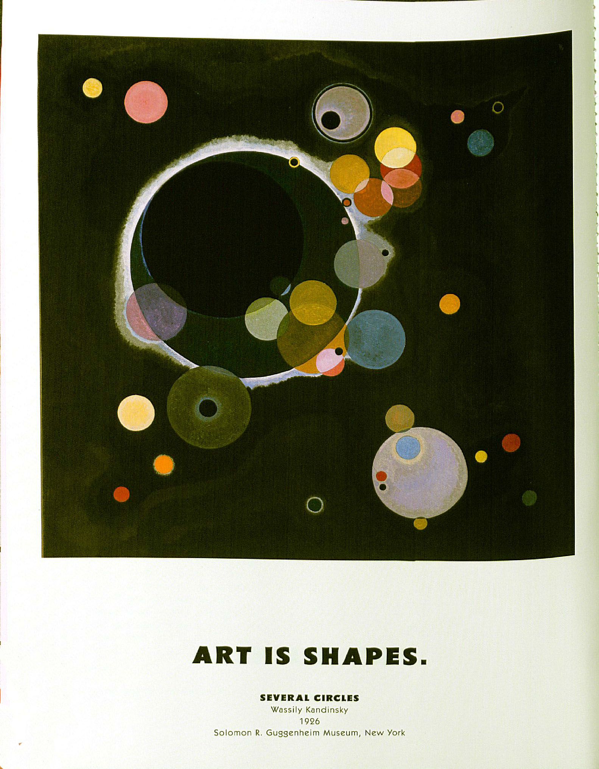
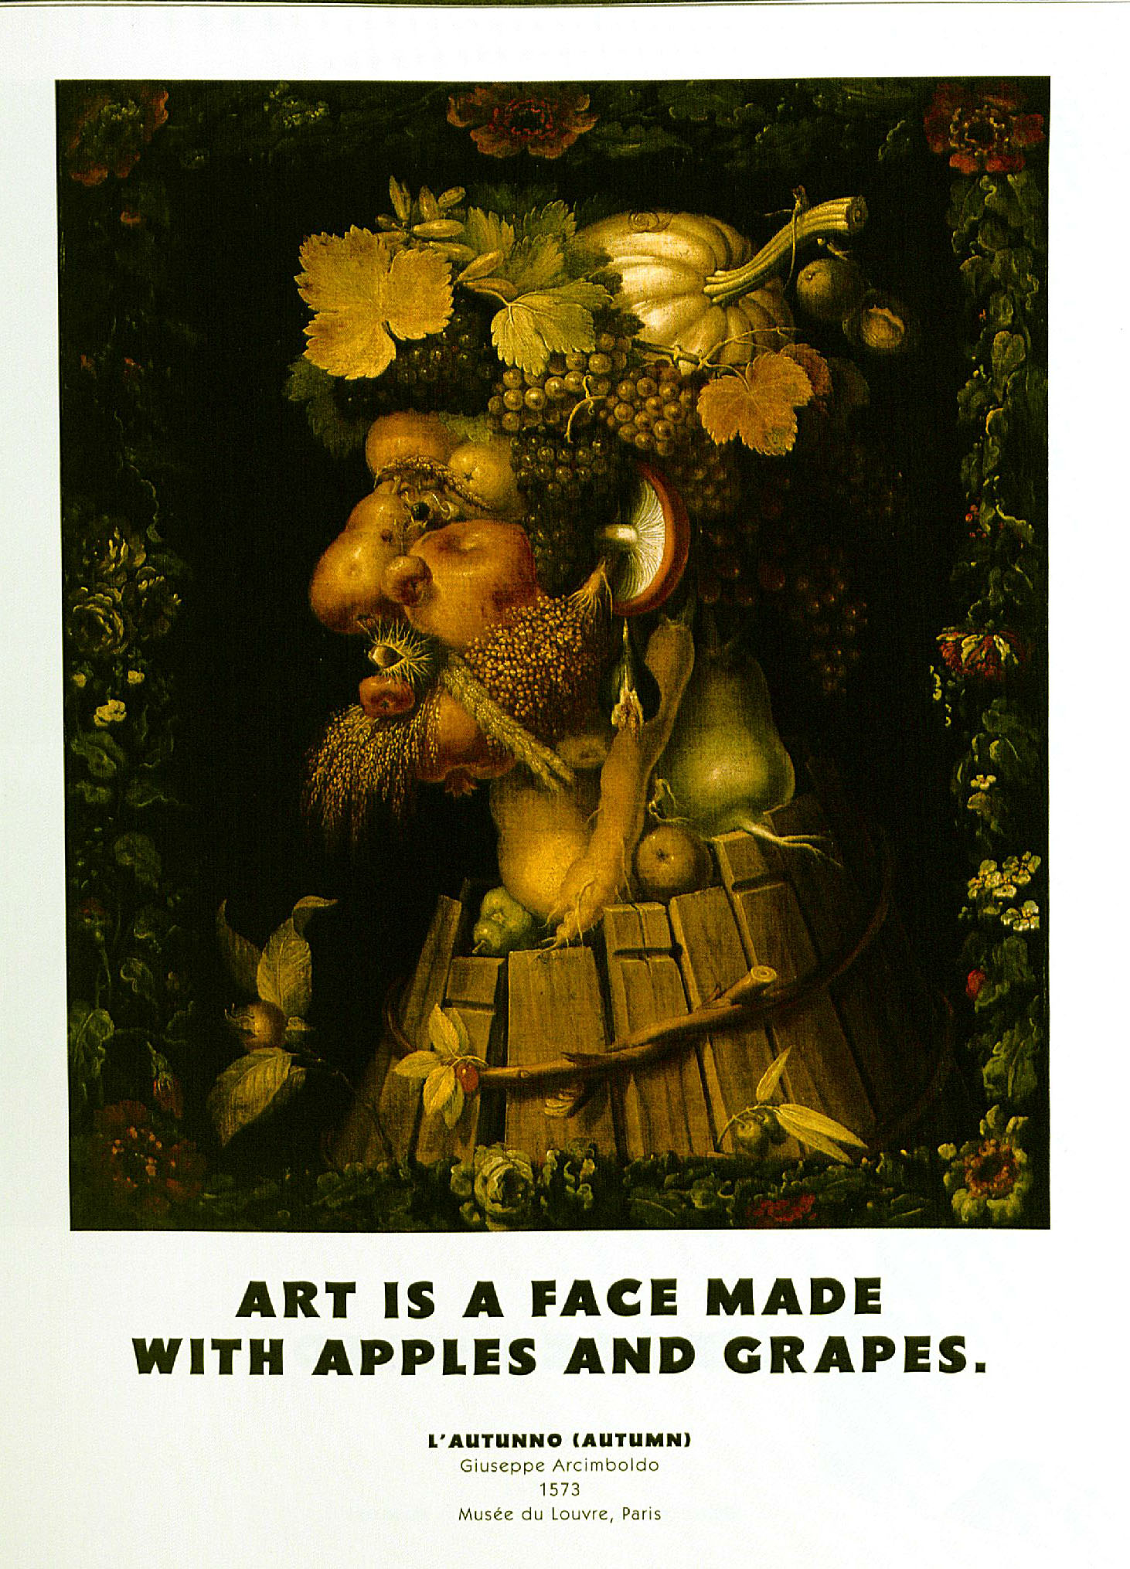

Slide 7
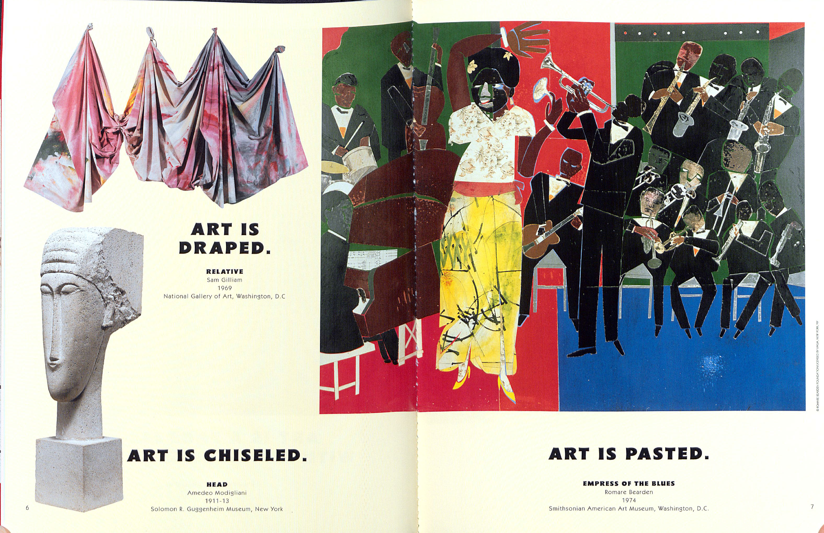

Slide 8
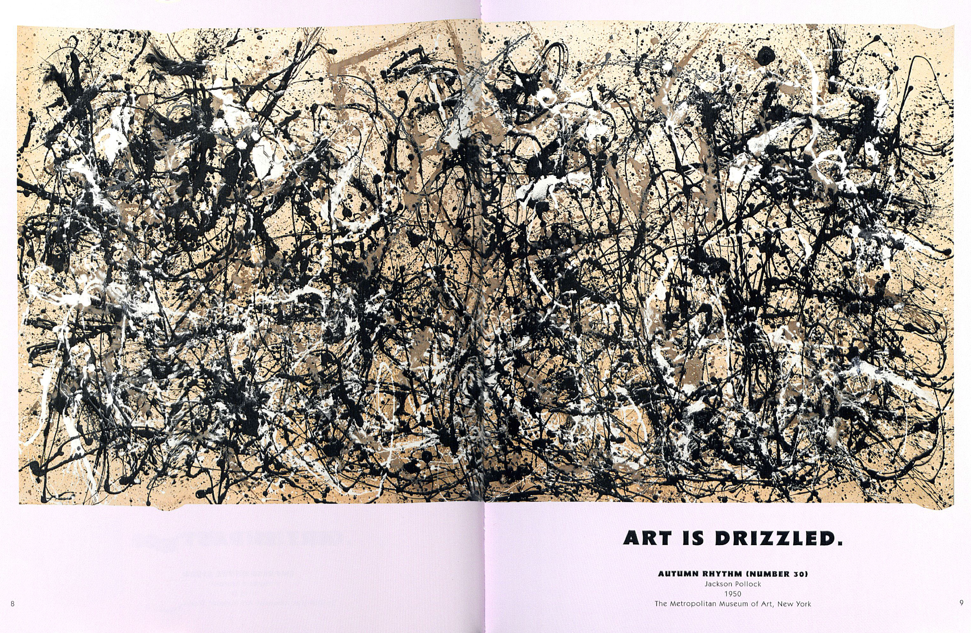

Slide 9
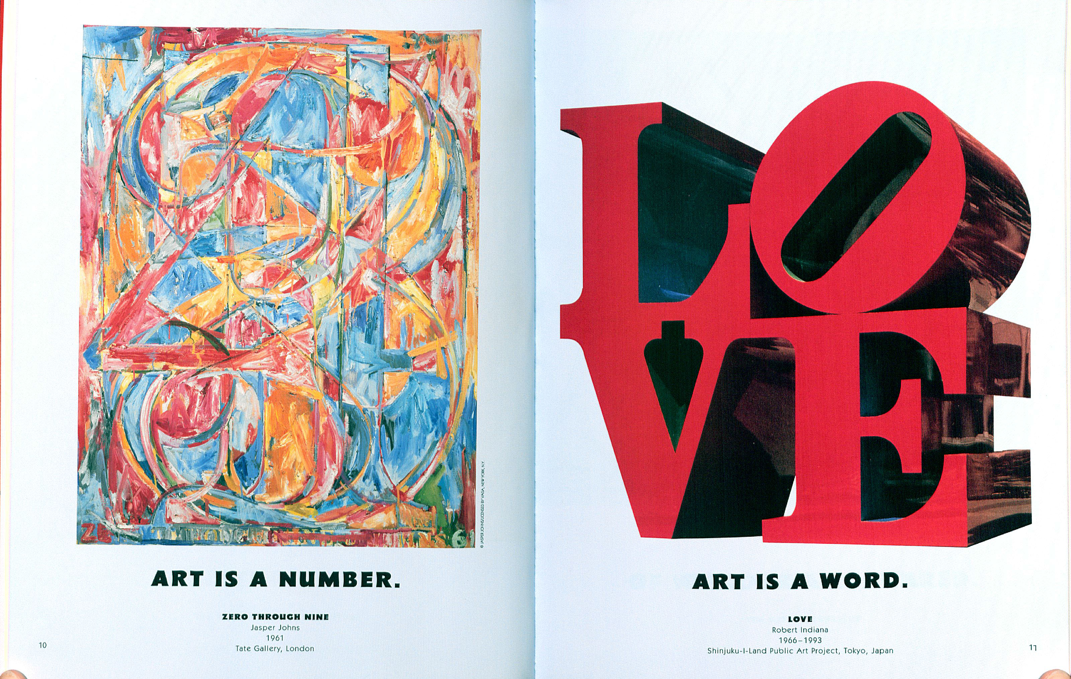

Slide 10
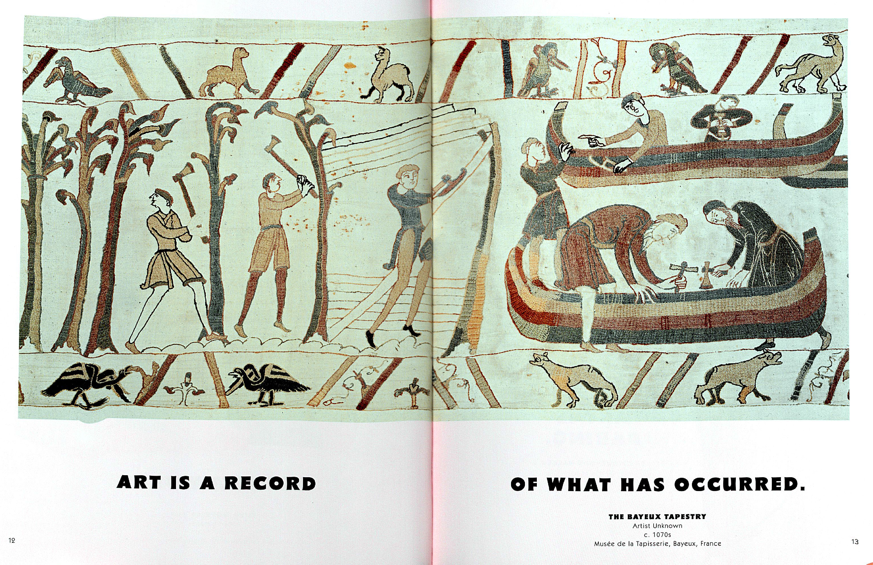

Slide 11
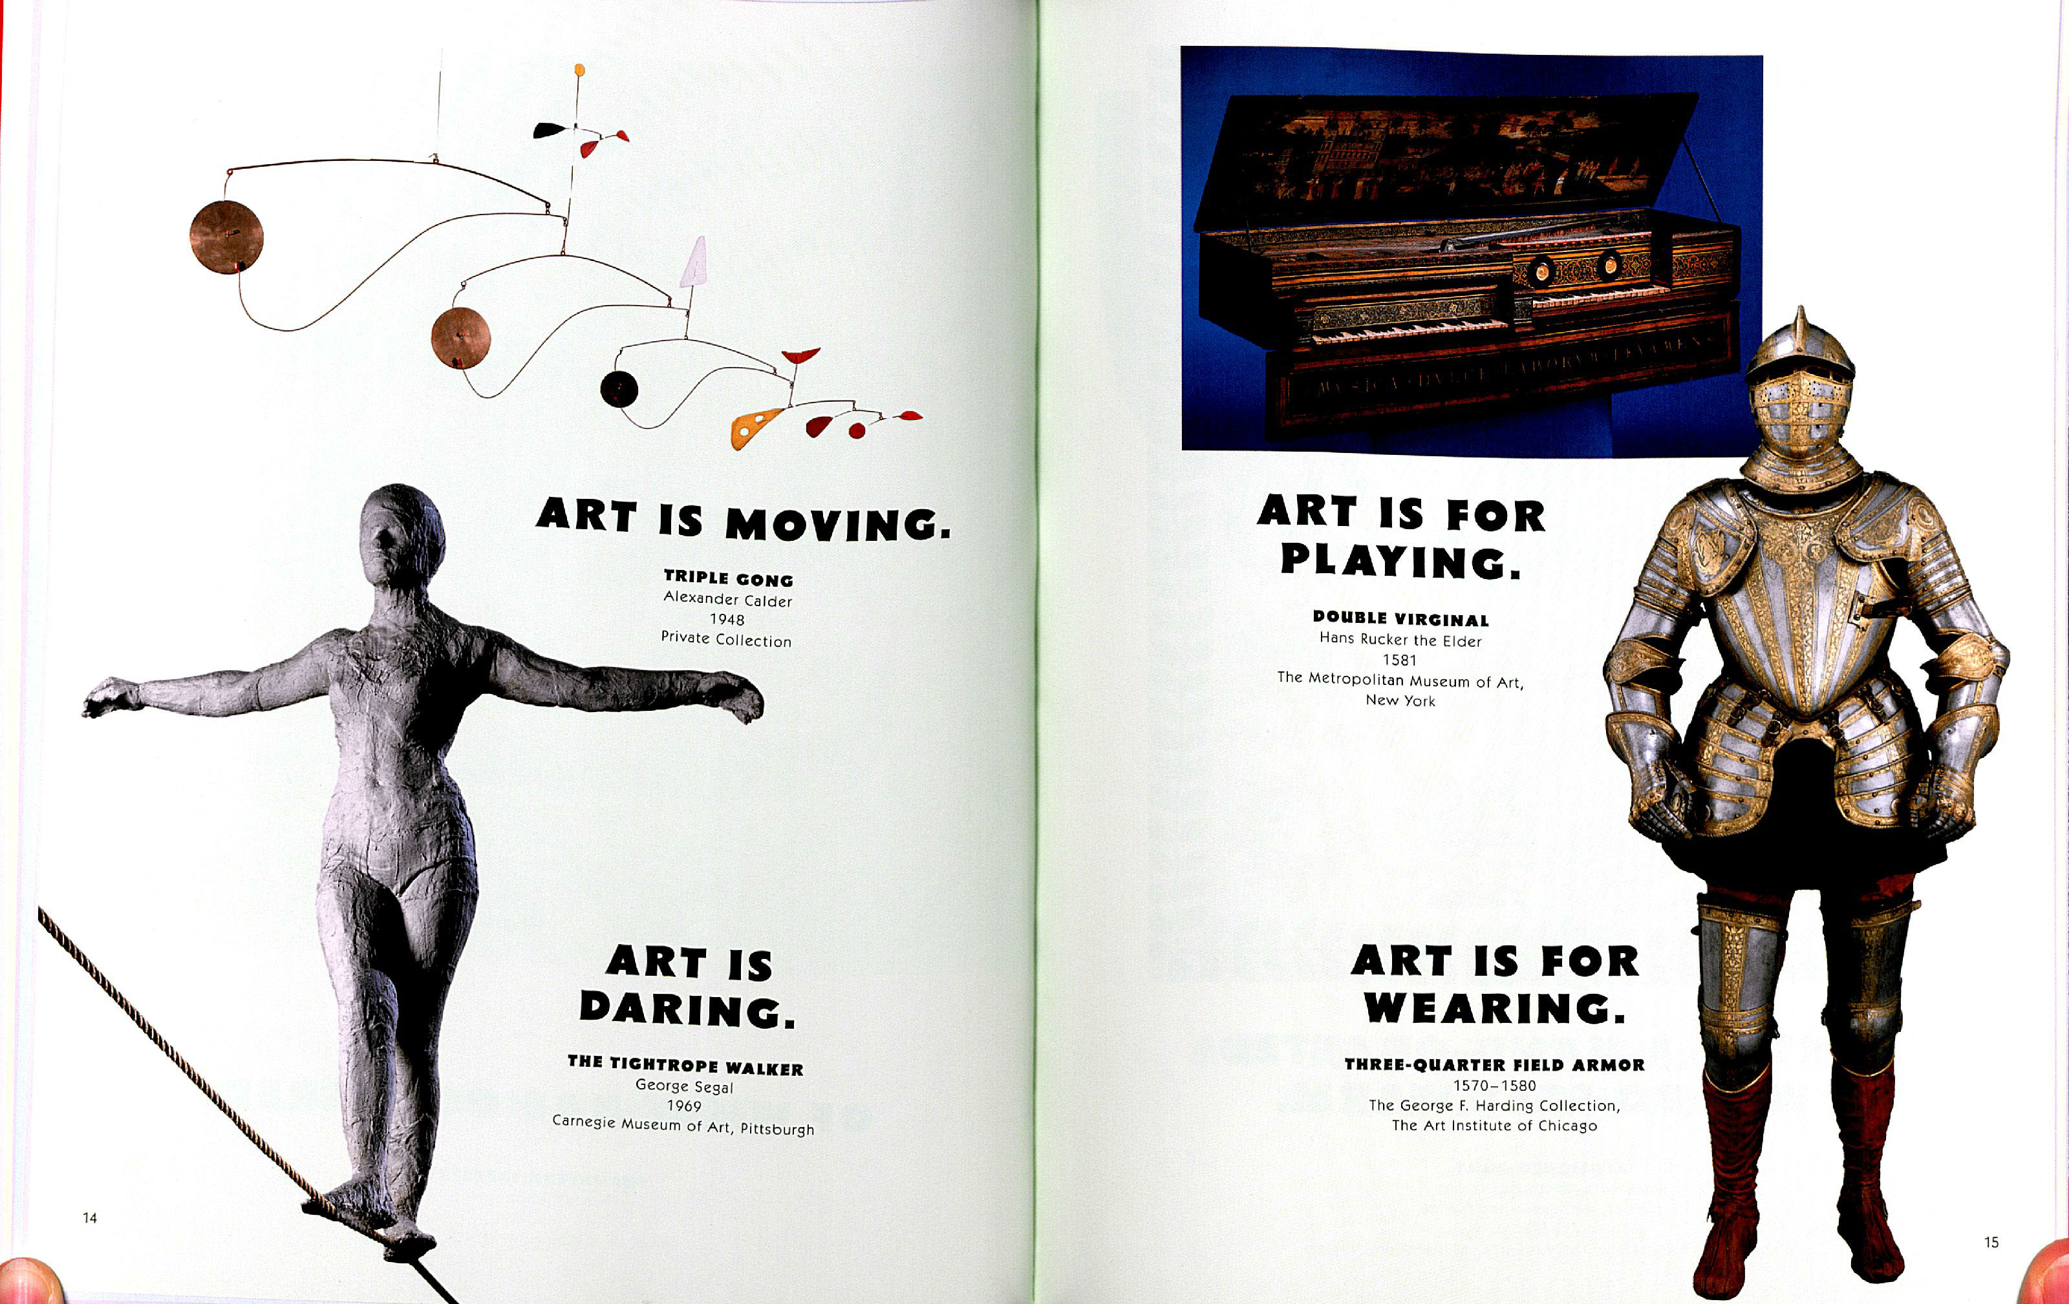

Slide 13
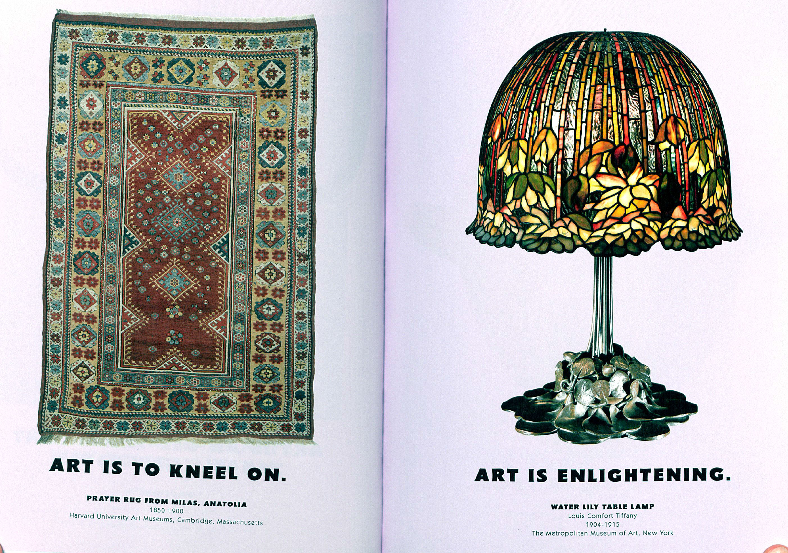

Slide 14
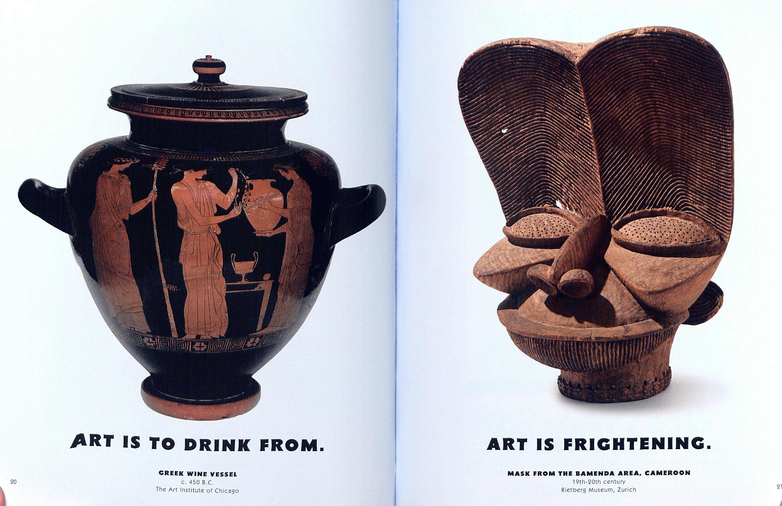

Slide 16
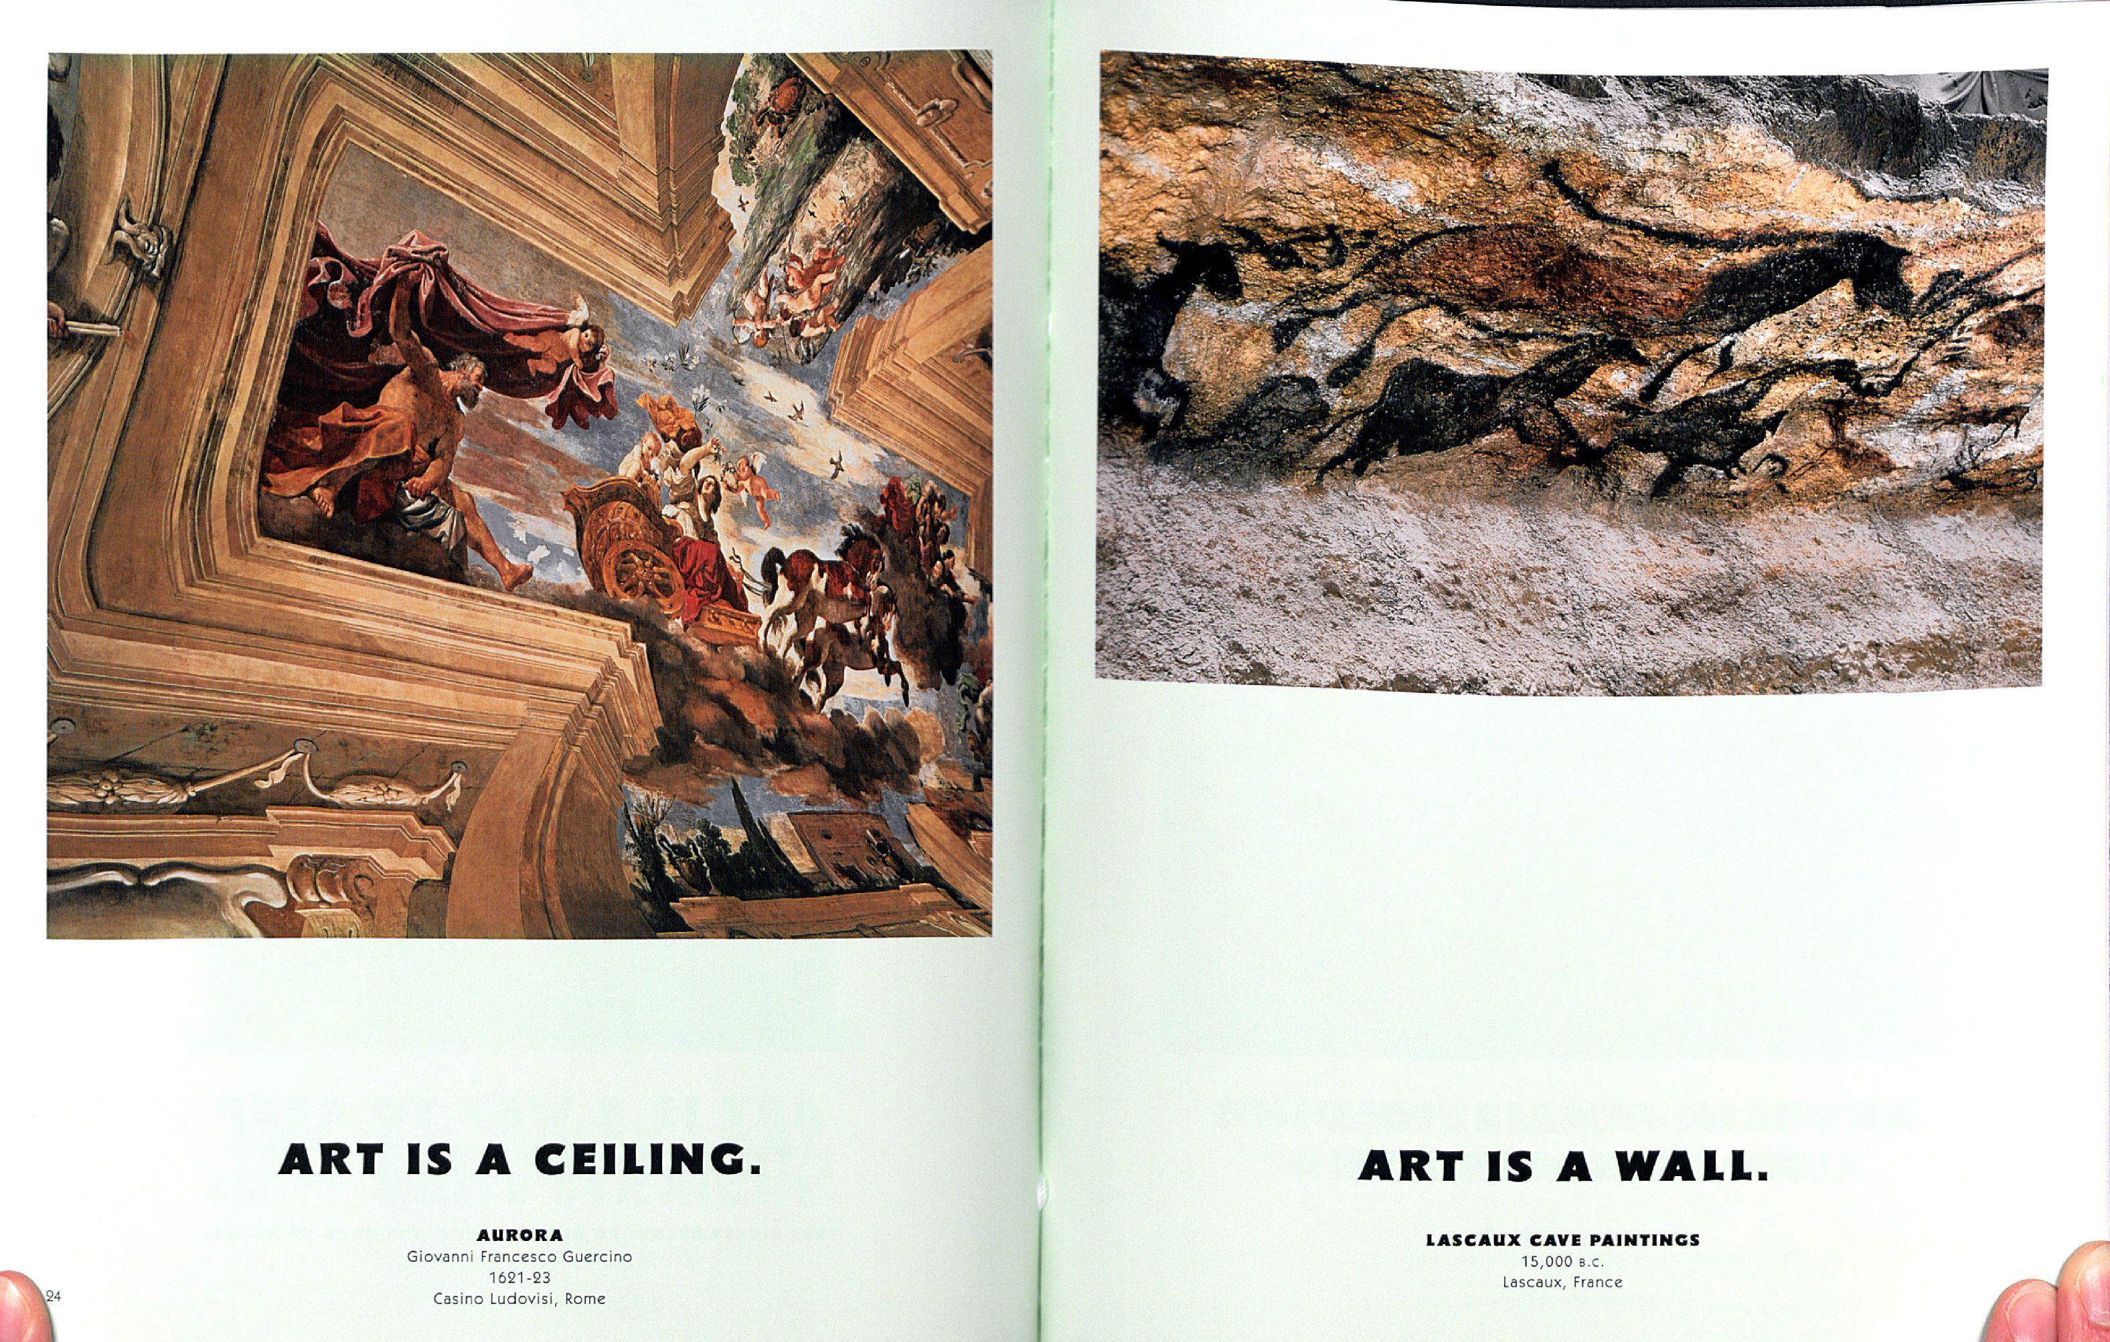

Slide 17
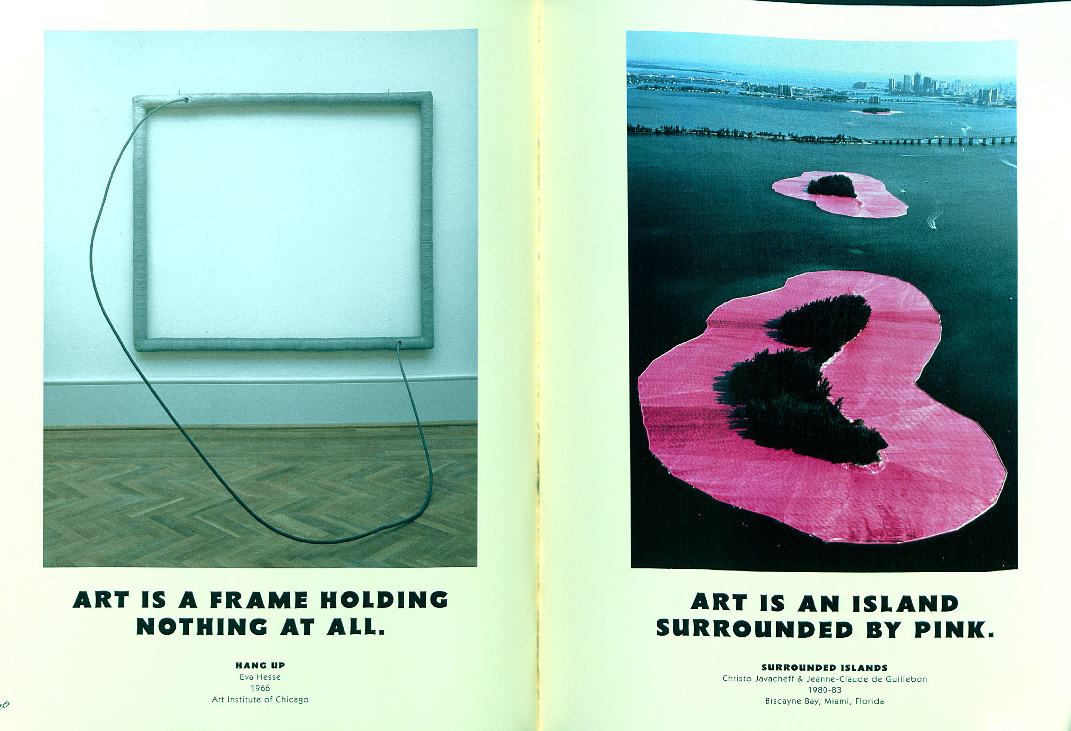

Slide 18
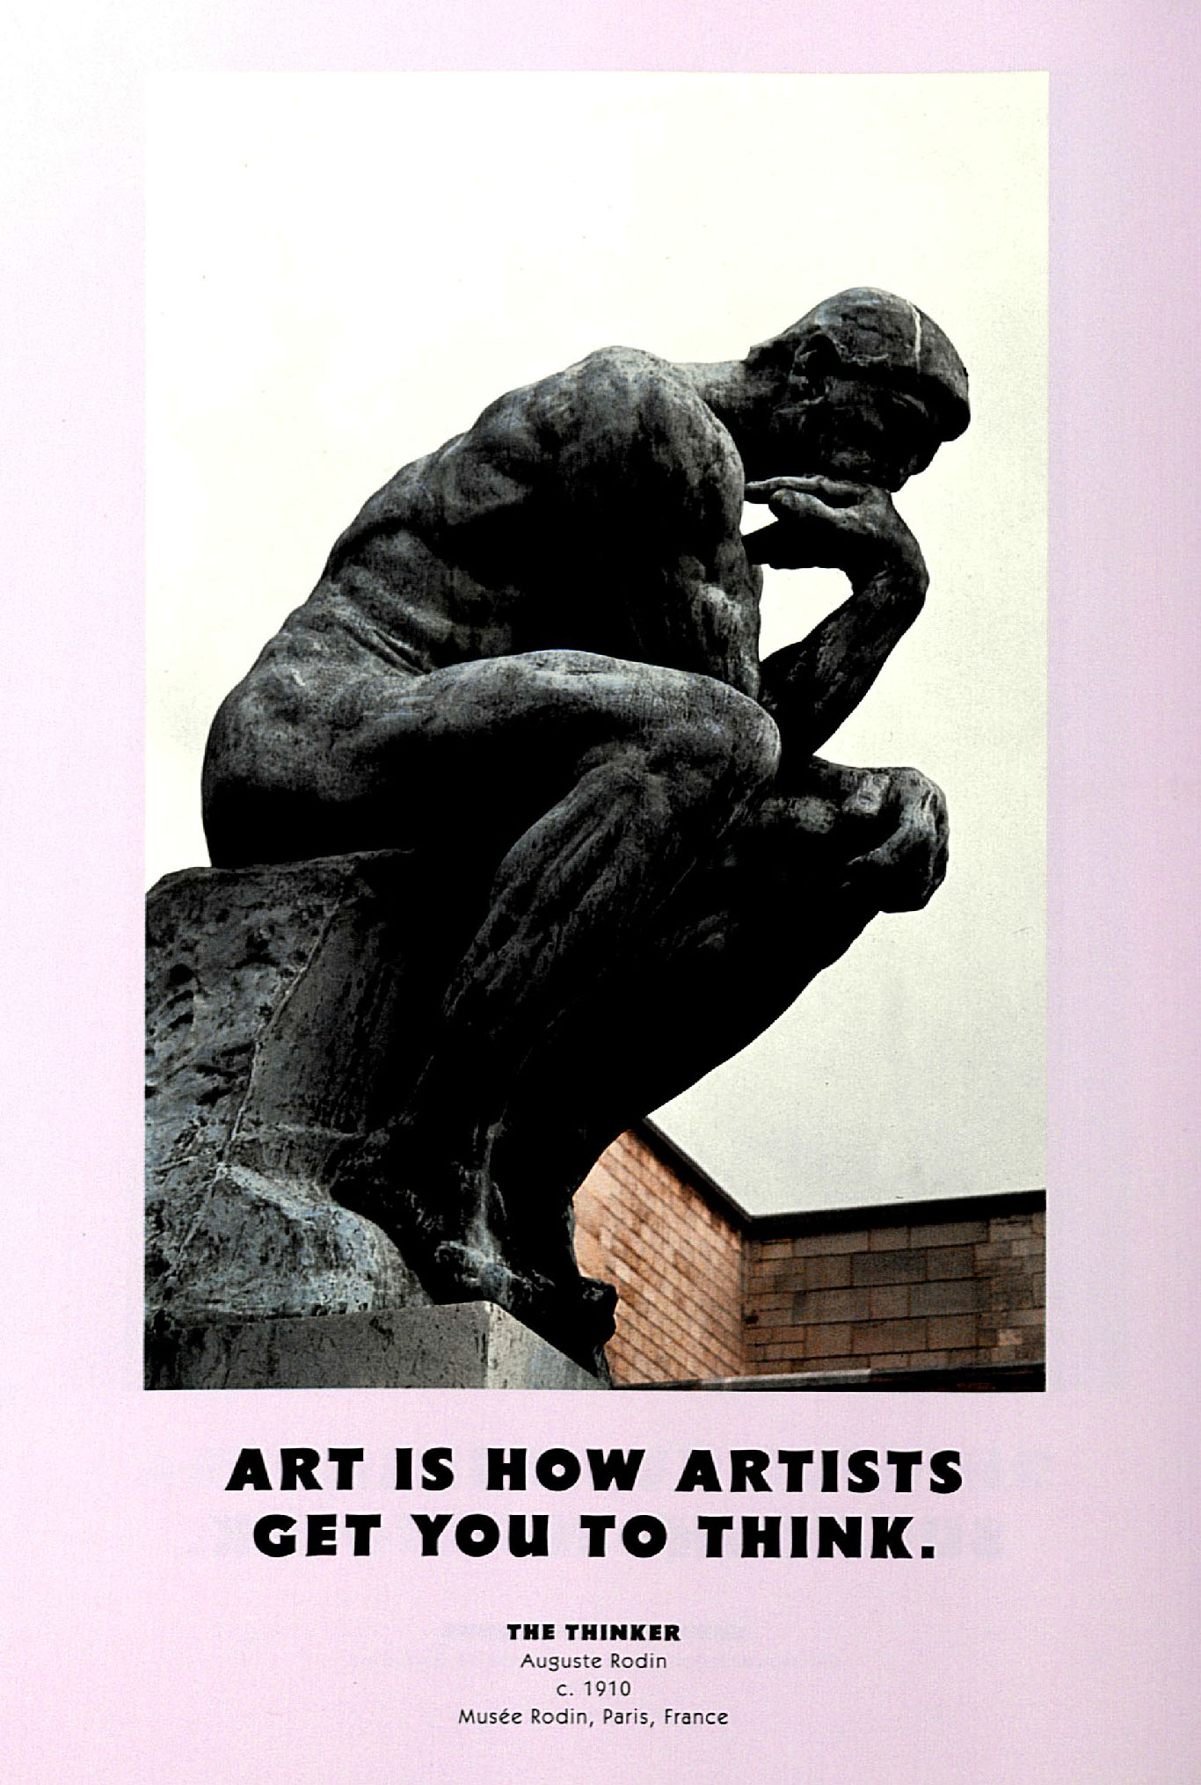

Slide 19
Think quietly to yourself.. 5. How do you define art now?

Slide 20
Choose one of these examples and
ask yourself….
6. How was it made?
7. What message does it communicate?
8. What is the mood and what about it creates this mood?

Slide 21
9. Where and when do you
think this was
made?
10. What do you think it meant to the people who lived in that place and time?
11. What does it mean to you now? Why is there a difference?

