Slide 1
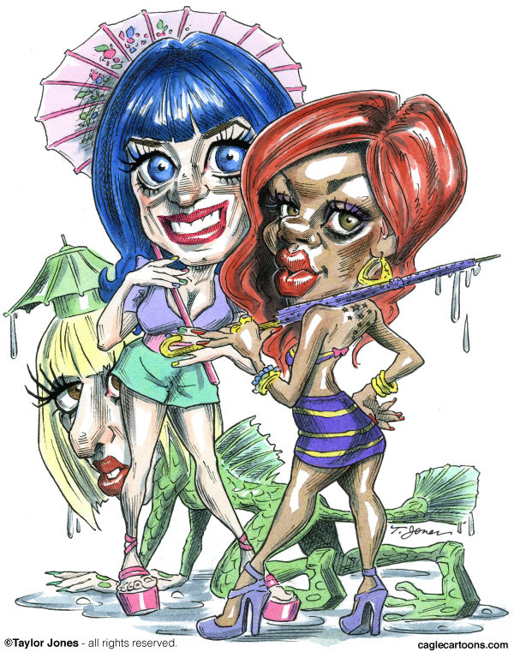
Celebrity Cartoons

Slide 2
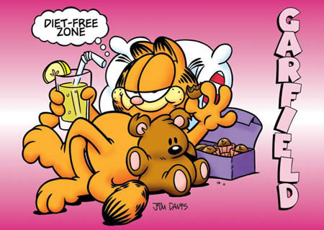
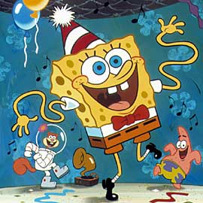
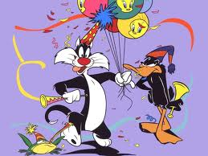
cartoon - A kind of drawing done to get people thinking, angry, laughing, or otherwise amused, often accompanied by a caption.

Slide 3
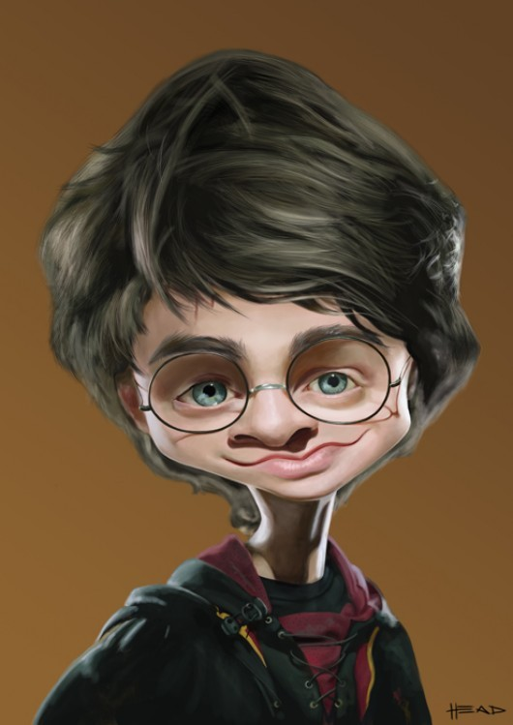
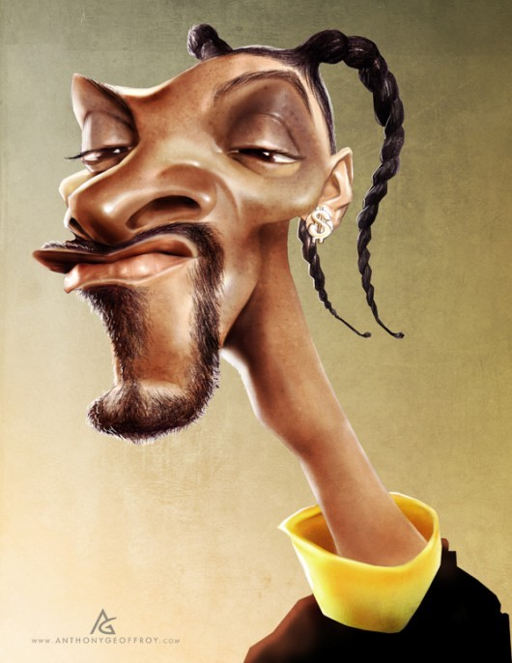
caricature-a representation of a person in which his/her features are distorted or exaggerated to create a comic effect.

Slide 4
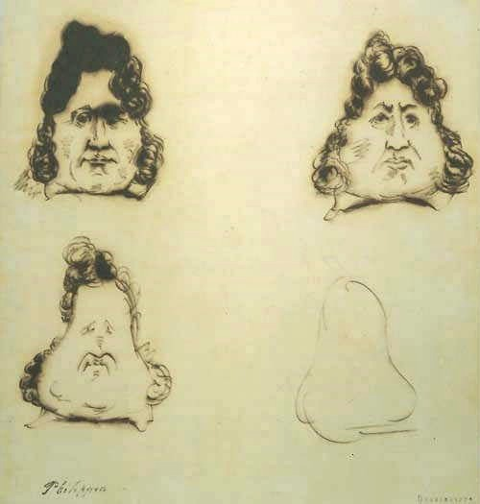
Cartoons and caricatures have provided entertainment for centuries. This example was created in 1831.
Charles Philipon (French, 1800-1862), The Metamorphosis of King Louis-Philippe into a Pear),
c. 1831,

Slide 5
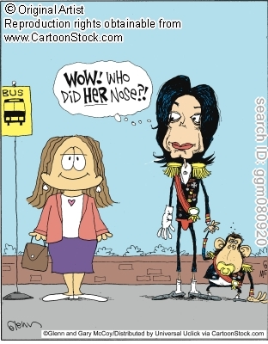
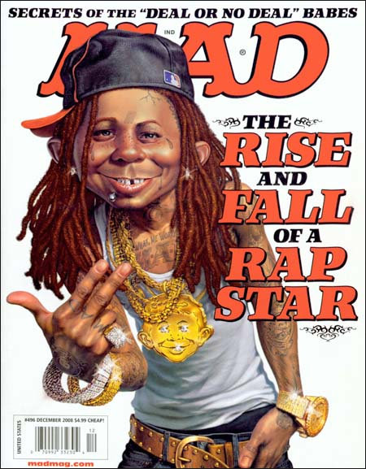
Caricatures often present famous people in a humorous way by poking fun at their physical appearance, their personality, or the situations they get themselves into.

Slide 6
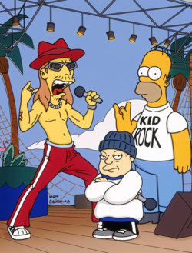
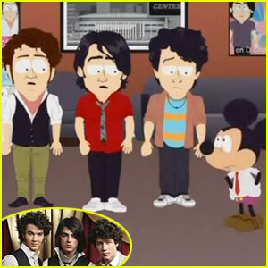
Animators include famous people in their cartoons to add real life humor to their fictional stories.

Slide 7
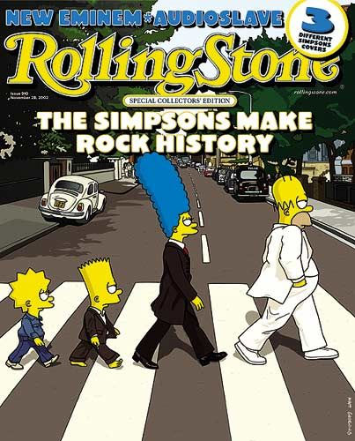
One approach to creating celebrity cartoons involves situating the famous person in an unexpected environment.

Slide 8
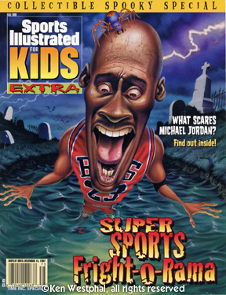
What message do you think the artist is trying to communicate in this cartoon?
What is the mood?
Why do you think this way?

Slide 9
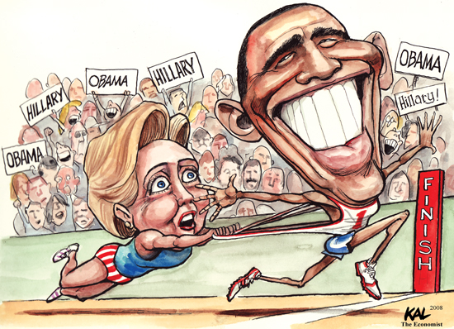
What message do you think the artist is trying to communicate in this cartoon?
What is the mood?
Why do you think this way?

Slide 10
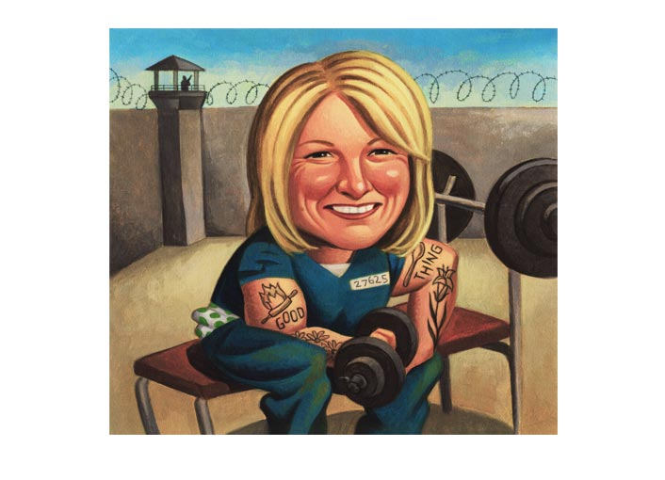
Placing celebrities in shocking or absurd environments is not only funny, but it also questions our perception of reality. We have to think twice about their true personality verses the one they portray to the public.
What message do you think the artist is trying to communicate in this cartoon?
What is the mood?
Why do you think this way?

Slide 11
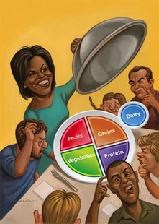
What message do you think the artist is trying to communicate in this cartoon?
What is the mood?
Why do you think this way?

Slide 12
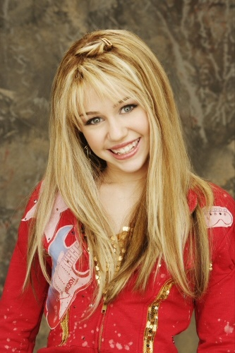
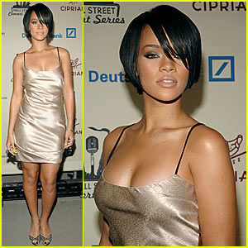
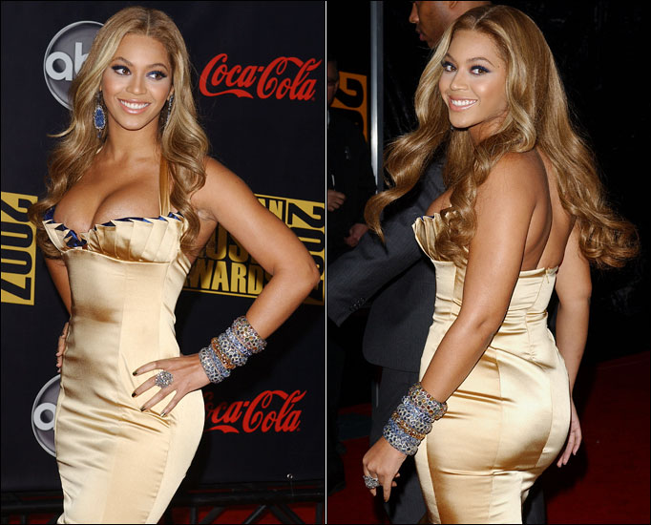
You are going to create a celebrity cartoon using one of the following famous people.

Slide 13
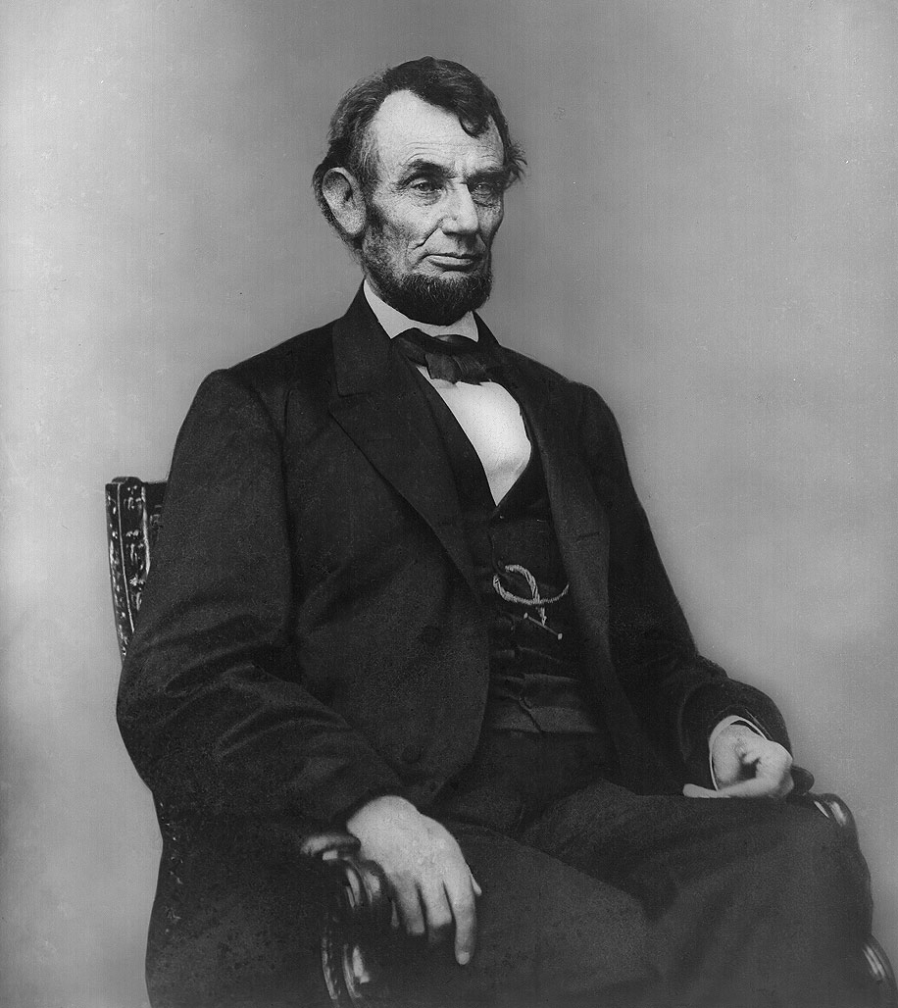
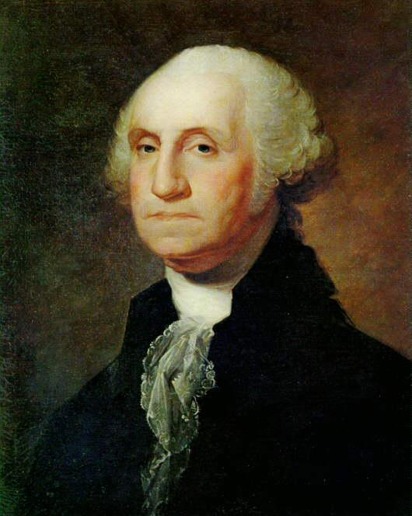
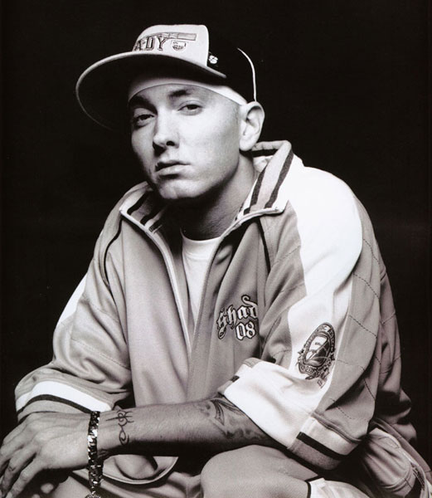
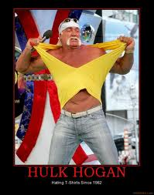
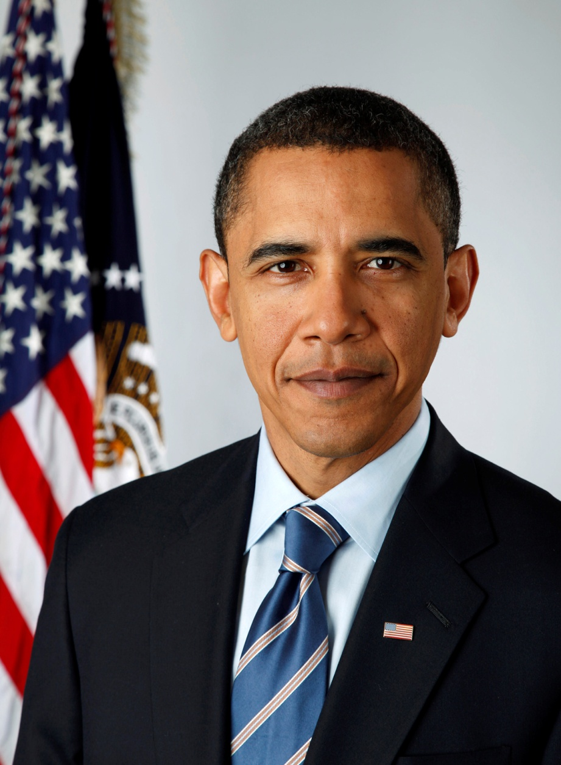
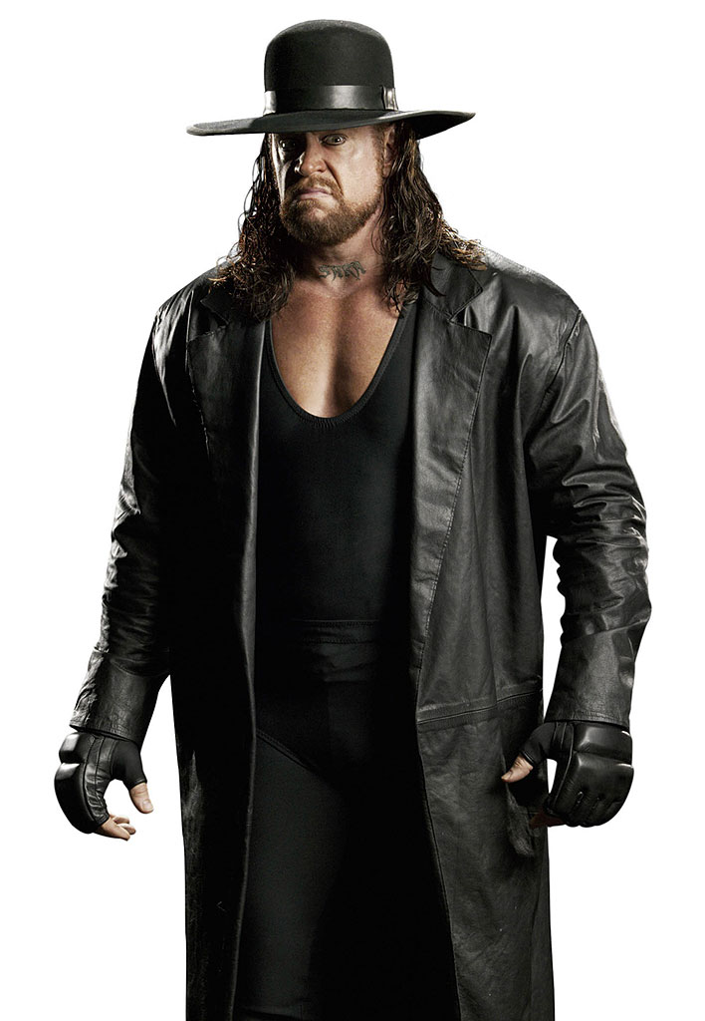
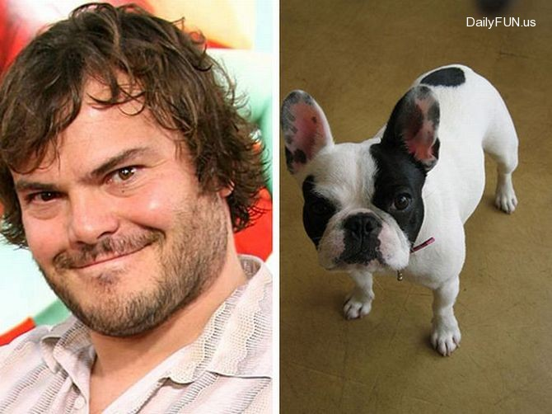

Slide 14
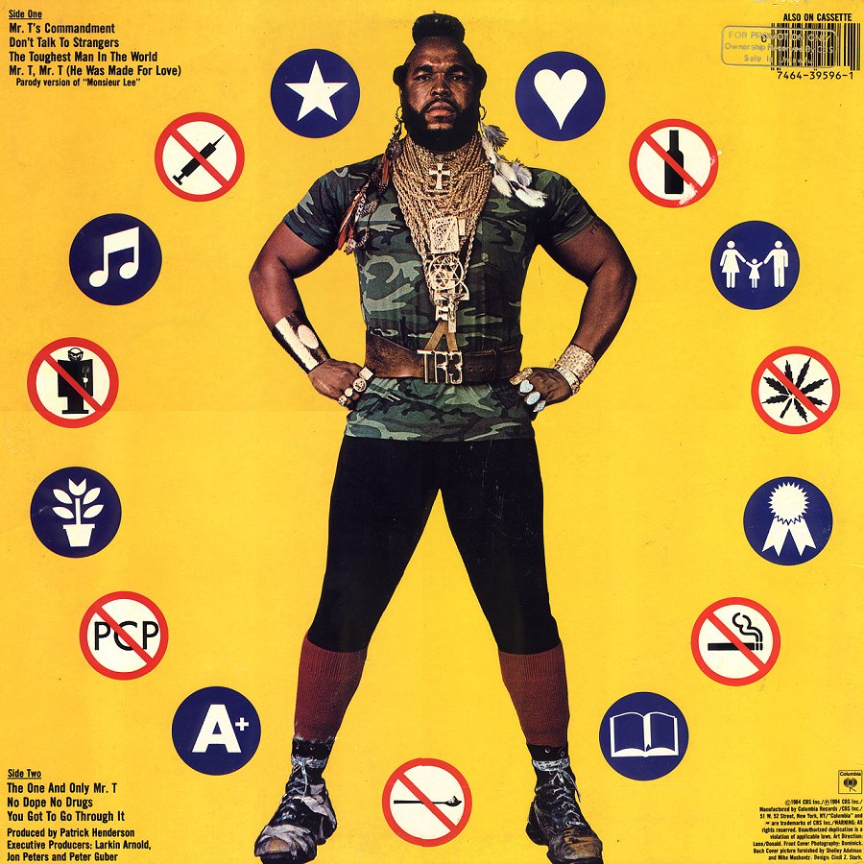
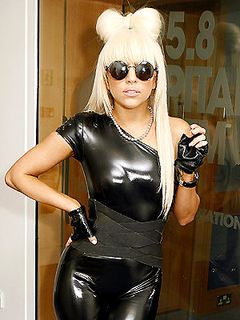
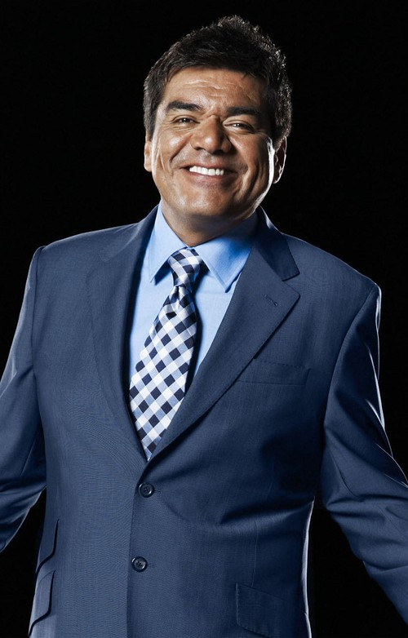
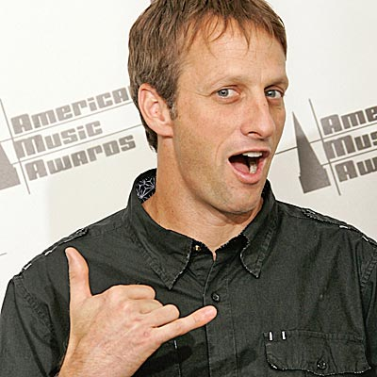
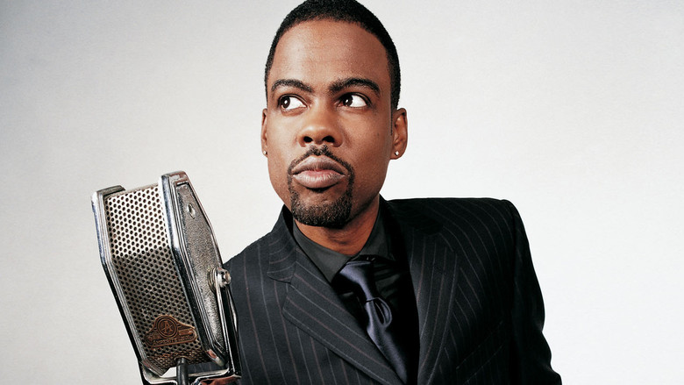

Slide 15
