Slide 1
SET TRANSPARENT COLOR
Adding glow
Adding shadow

Slide 2
Texting & Driving
ACCIDENT STATISTICS

Slide 3
Presentation Links
adding actions
using shapes
changing link color

Slide 4
COURSE OBJECTIVES
Signing in
PowerSchool Graph

Slide 5
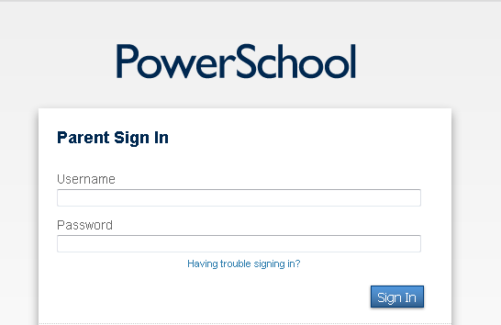

Slide 6
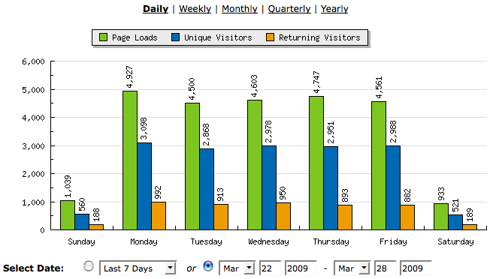

Slide 7
WORKING WITH PICTURES
COMPRESSING PICS
SELECTION PANE

Slide 8
