Slide 1

Synthetic Drugs
K2 Spice

Slide 2
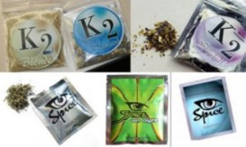
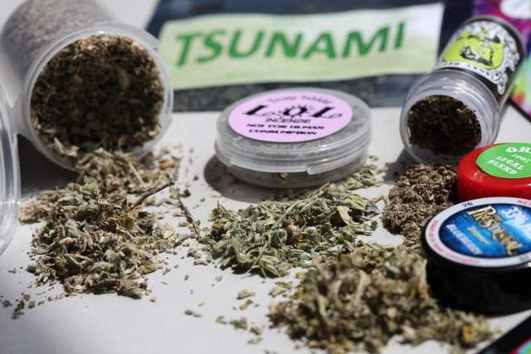
Synthetic Marijuana K2 Spice
Notes:
K-2 Spice is a legal substance marketed since 2006 as a dried, herbal blend for use as an incense.
The product is sold in a variety of small foil colored packaging or small glass containers.
Can also be sold in small glass containers

Slide 3
What is Synthetic
K2 Spice?
POISON sprayed on leaves
  K2 or Spice is a mixture of herbs, spices or shredded plant material. “Fake Weed” that resembles potpourri.
  It is sprayed with a synthetic compound chemically similar to THC.
  Marketed as a “Legal High.”
Notes:
Spice has been found to contain JWH-018, JWH-073, and HU-210, all are artificial chemical compounds.
None of these chemical compounds are guaranteed safe for human consumption.
This is why people are smoking the incense, it produces a high similar to marijuana, but has a longer duration.
THC is the main psychoactive – mind altering chemical in marijuana

Slide 4
Marketed Under the
Following Names
K2
Spice
Pep Spice
Spice Silver
Spice Gold
Smoke
Skunk
Red X
Yucatan
Fire
Genie
Zohai Orange
Dragon Smoke
Black Mamba
Blaze
Dawn
Notes:
There are a lot of different terms for K2 – some of the most common are:
As I stated none of them are for human consumption. It states this on the packaging.
Spice is sold in smoke shops, head shops, gas stations, and online.
The average cost is $30.00 a gram, more expense than marijuana.

Slide 5
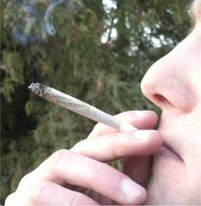
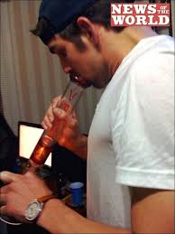
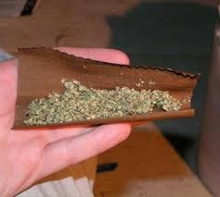
How is K2 Abused?
Like Marijuana--K2 is usually smoked
As a cigarette (Joint)
In a pipe or water pipe. (Bong)
In hollowed out fruit (e.g. apples, pears)
In “blunts” that are cigars hollowed
out and refilled with a mixture of k2
and tobacco.
It can be mixed with food or brewed as a tea.
Like marijuana, K2 can be combined with other
drugs such as PCP or cocaine.
Notes:
Like Marijuana K2 is also smoked
as a hand-rolled cigarette, which is usually called a joint.
It can be smoked in a pipe or water pipe, which is called a bong,
or in “blunts,” which are cigars that are hollowed out and refilled with a mixture of marijuana and tobacco.
Marijuana can be mixed in food, brewed as a tea
and is often combined with other drugs, such as PCP.

Slide 6
Use of Synthetic K2
Is Alarming HIGH
  According to the data from the 2011 Monitoring the Future survey of youth drug-use trends:
      11.4 percent of 12th graders used Spice or K2 in the past year
      making it the second most commonly used illicit drug among seniors.

Slide 7
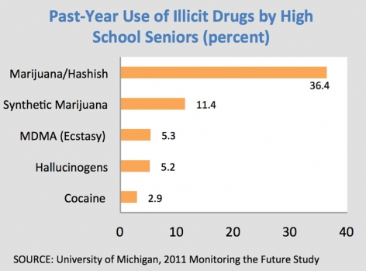
Use of Synthetic K2
Notes:
The graphic depicts the drugs used by seniors. K2 being the second highest.

Slide 8
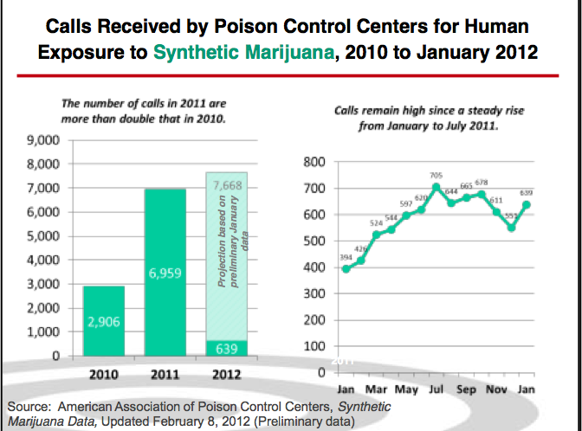
K2 Rapidly Emerging
Health Threat
Notes:
This chart represents calls to the American Association of Poison Control Centers across the Nation.
In 2010 , 2,906 calls relating to human exposure to synthetic K2 were received.
Twice that number 6,959 were received in 2011,
and 639 have been received as of January 2012.

Slide 9
Synthetic Marijuana K2
How does it AFFECT the Brain?
Effect is similar to marijuana (can be more potent)
Developed for Research, Never Tested on Humans
Symptoms or side effects can include the following:
Increased Agitation
Vomiting
Increased Blood Pressure
Increased Heart Rate
Partial Paralysis
Increased Body Temperature
Temporary Inability to feel pain
Seizures
Excessive Sweating
Paranoid Delusions
Depression
Hallucinations
Exaggerated Thoughts of Suicide
Feeling of Impending Doom (Death)
Tremors
Panic Attacks
Organ (Kidney) failure
Notes:
Depending on the synthetic compound in the specific commercial brand, it can be more potent than marijuana, as much as 500 to 800 times.
The compound most commonly found in these products is a chemical first synthesized by a well known Clemson University organic chemist, Dr. John Huffman.
His research project was studying cannabinoid receptors for the National Institute for Drug Abuse (NIDA) but never tested on humans nor approved by the FDA. When interviewed Dr. Huffman stated “It is like playing Russian roulette to use these drugs. We don’t know a darn thing about them and they shouldn’t be out there.”
K2 is often contaminated with unidentified toxic substances which contribute to significant health risks and adverse side effects.
Such side affects as:

Slide 10
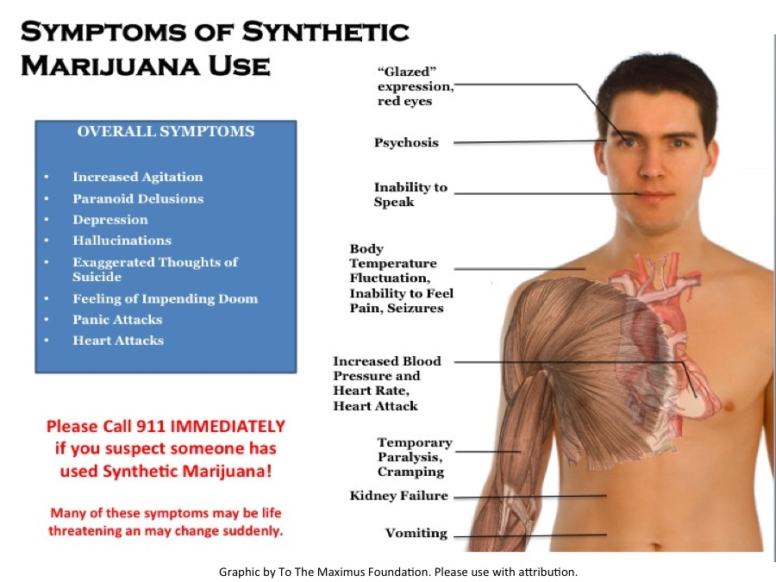
Symptons of Synthetic
Marijuana Use

Slide 11
Why Isn’t K2 Illegal?
It is a “Designer Drug”
Spice is currently not illegal in most US States
Spice is difficult to detect and regulate
Many European countries deemed the chemical components of Spice illegal.
17 U.S. states have bans on K2.
New York, Texas, and New Jersey are considering legislation.
An organized effort is currently taking place in Arizona to ban K2.
Notes:
a drug that has been modified to take advantage of loopholes in the legal system
Despite having so many of the same properties as marijuana.
S
Since the drug does not show up on the same tests that work for marijuana.

Slide 12
What Can You DO?
Educate yourself and your communities.
Know the signs and address issues with students.
  Act right away.
  Focus on one goal: You do not want them to use these substances. Stick to straight forward factual information.
  Let them know you are concerned.
  Inform students on District policies and consequences.
  Be vigilant--monitor – Look for evidence and document, keep track and follow up with the students and their families.
  Communicate frequently and educate parents and students.

Slide 13
Parent Resource
http://www.tothemaximus.org

Slide 14
Additional Resources on
Substance Abuse
http://www.whitehouse.gov/ondcp
http://www.justice.gov/dea/pubs/pressrel/pr030111.html
http://www.drugabuse.gov/infofacts/Spice.html
http://www.aapcc.org/dnn/default.aspx
http://www.fas.org/sgp/crs/misc/R42066.pdf
http://www.drugfree.org/drug-guide/k2spice

