Slide 1

An introduction

Slide 2
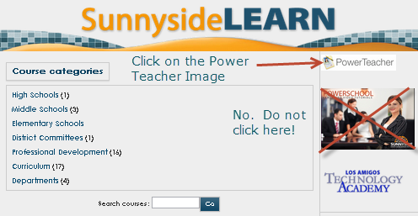
Please go to Learn
http://learn.susd12.org/

Slide 3
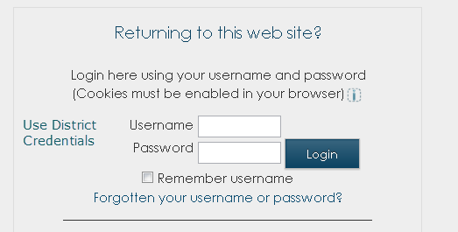

Slide 4
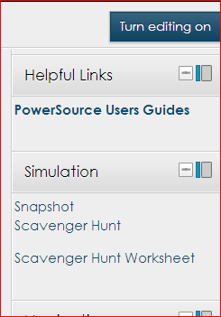
In the upper right hand corner, locate the simulation, mysteriously called, “Snapshot”. We will be working with snapshot and the scavenger hunt.
Click snapshot to download the simulation. It is a program. Run it

Slide 5
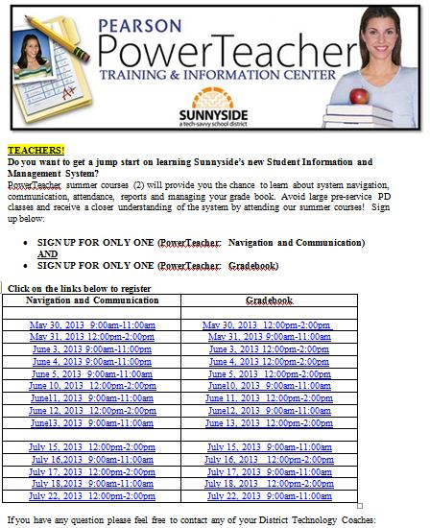

Slide 6
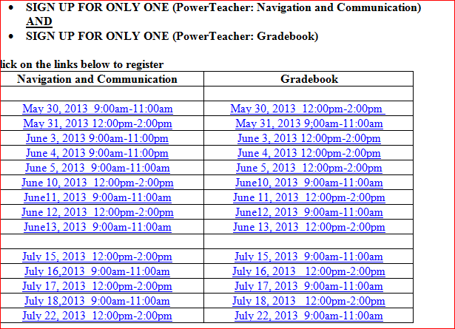
Power Teacher

Slide 7
To view the entire array of trainings or sign up for one of the trainings on the previous slide, you may click on the link below. Or use the links in the PowerTeacher Learn Page
http://www.susd12.org/node/4876

Slide 8
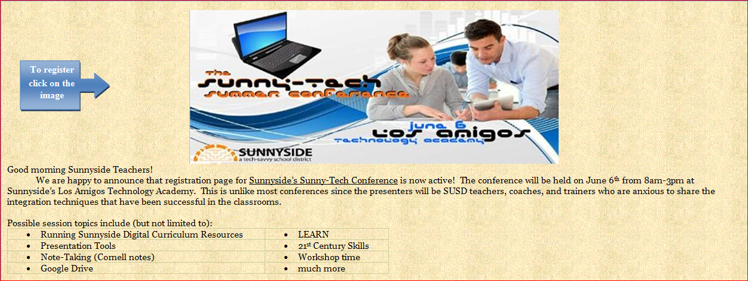
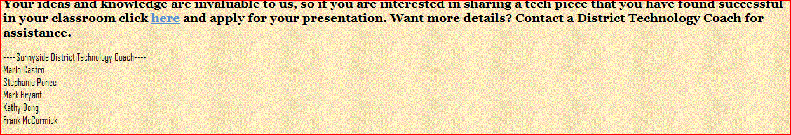
A Harmless Plug …
Sign up to attend Sunnytech Summer Conference
Sign up to present at SunnyTech Summer Conference

