Slide 2
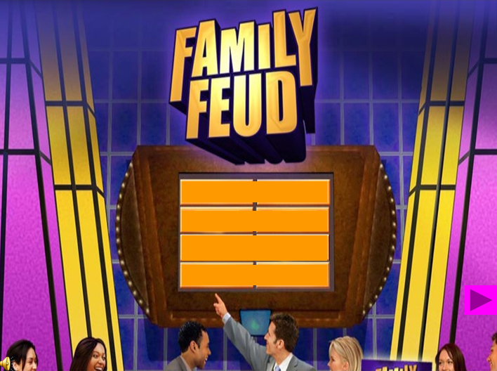

Slide 3
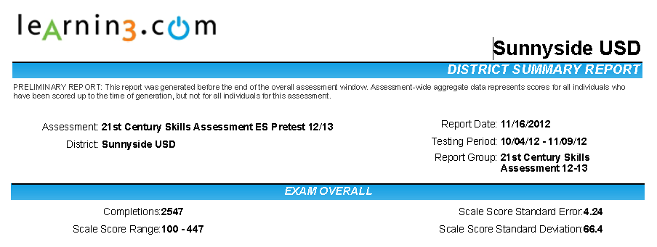
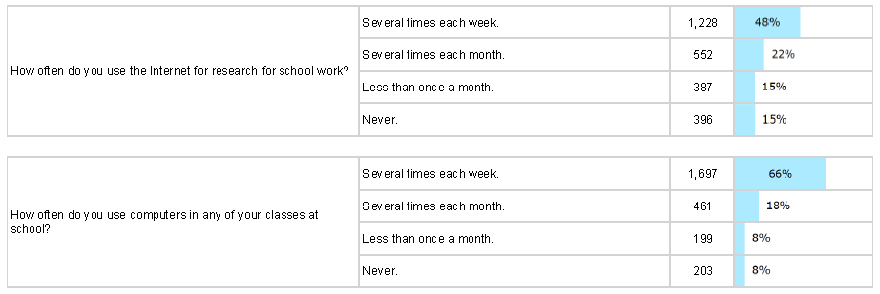

Slide 4
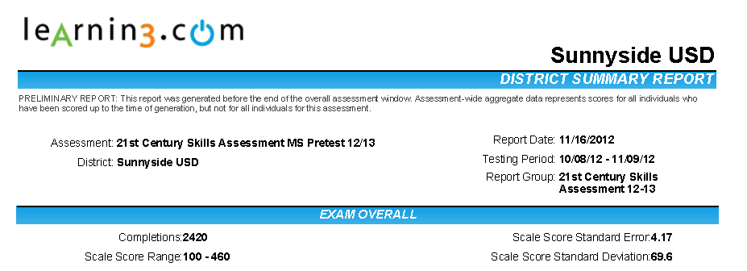
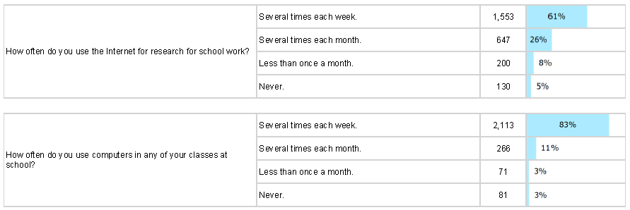

Slide 5
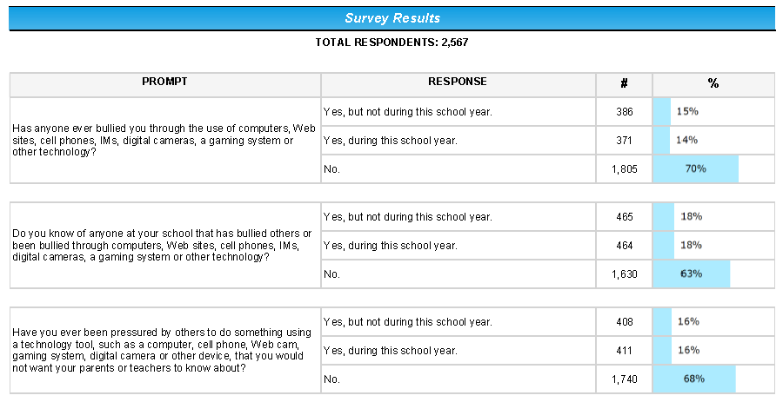

Slide 6
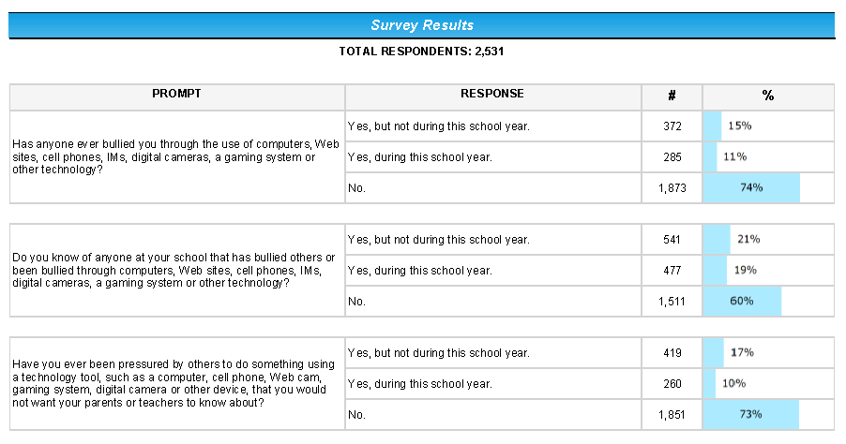

Slide 7
5 Myths about Technology Safety
5 mitos sobre la seguridad de la tecnología

Slide 8
Notes:
Begin the presentation with “Sarah” Video emphasizing the danger that exist online for our children and the commitment parent should make to learn as much as possible to minimize these dangers.

Slide 9
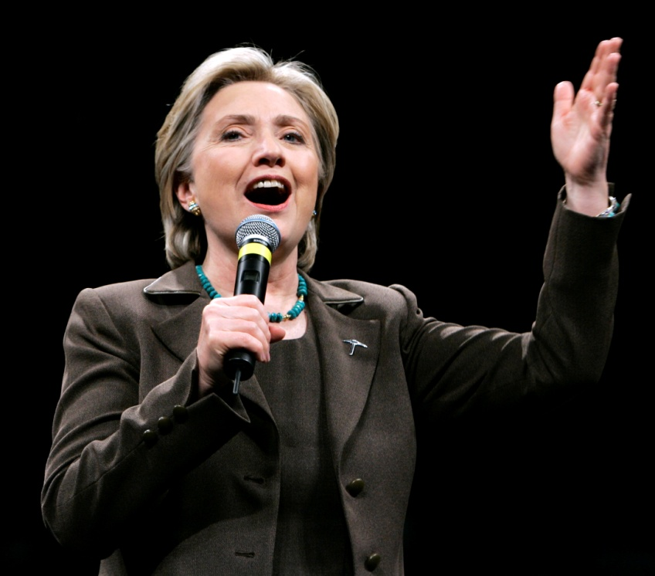
Myth 1
Your kids have all the answers when it comes to the use of computers.
Sus hijos tienen todas las repuestas cuando tiene que ver con el uso de la computadora
Notes:
Story about Hilary visiting desert view demonstrating how students don’t always make the right decisions.

Slide 10
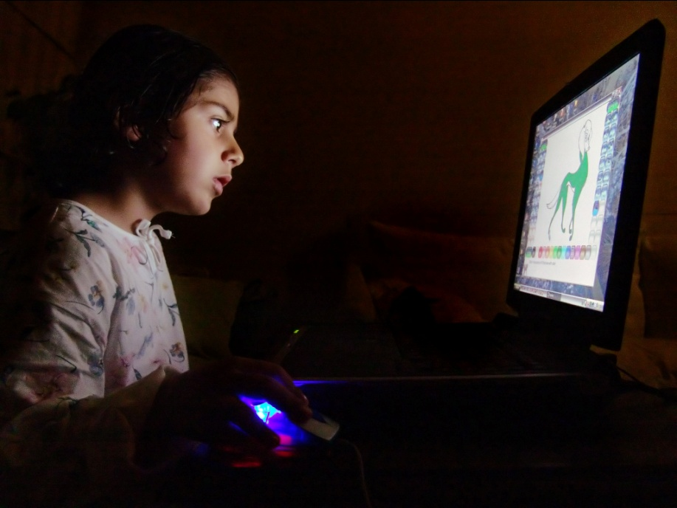
Myth 2
Taking away a child’s online privileges will keep the child safe.
48% of 16-17 yr olds report that their parents know "very little" or "nothing" about their online activities
FBI-online study
Quitando los privilegios de usar el internet mantendrá a mis hijos seguros

Slide 11
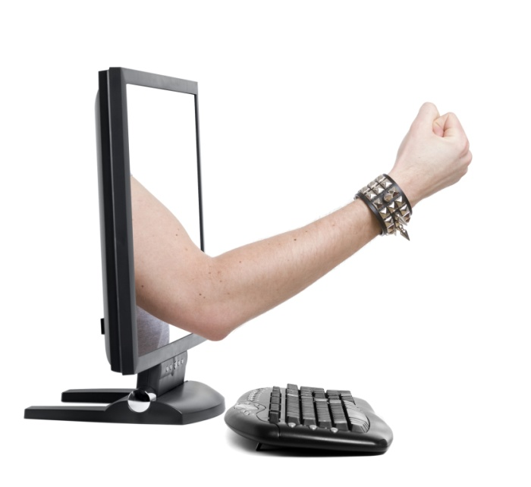
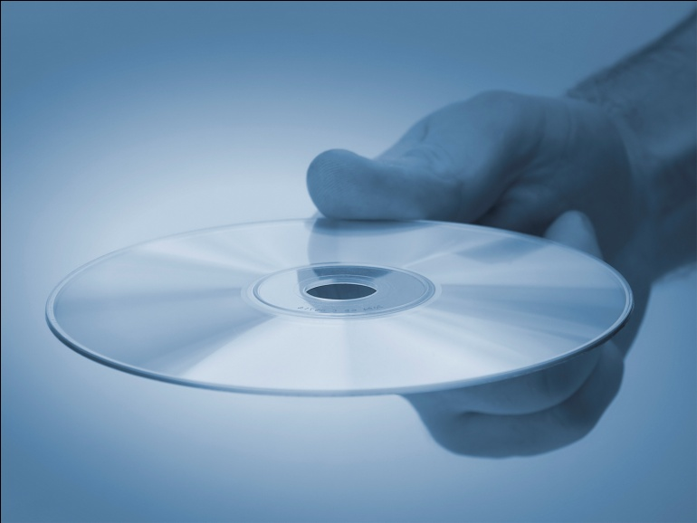
Myth 3
Your only concern should be for your child’s safety.
Solo me tengo que preocupar por la seguridad de mi hijo.
Your child could be the culprit (culpable) as well as the victim
Cyber bullying
(acosado, amenazado)
Illegal File sharing

Slide 12
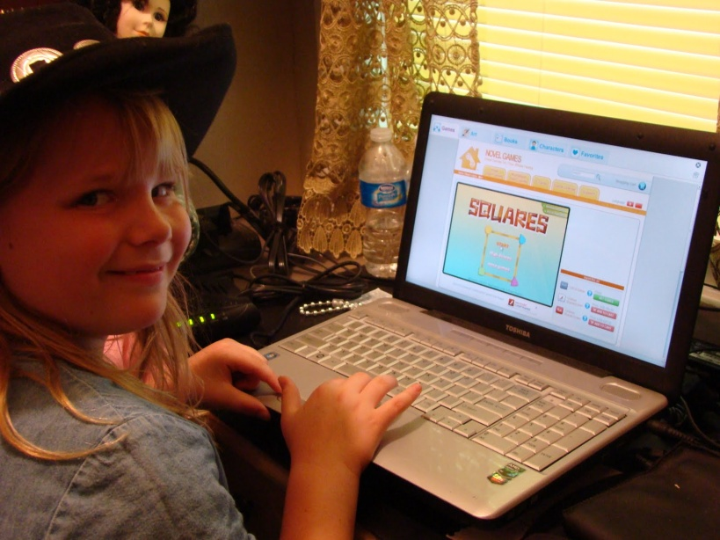
Myth 4
Technology can protect your computer and your child from online dangers. (PELIGROS)
75% of youth who received an online sexual solicitation did not tell a parent
FBI-online study
La tecnología puede proteger a mis hijos de los peligros del internet

Slide 13
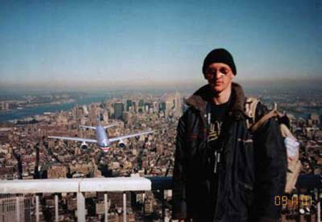
Myth 5
If it is on the Internet, it has to be true.

Slide 14
http://digitallife.today.com

Slide 15
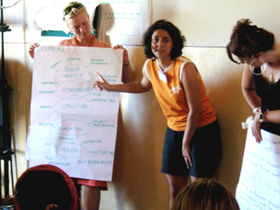
PARENT COLLABORATION

Slide 16
