Slide 1
End of WWI

Slide 2
1917
February 1, 1917 - Germany again declares unrestricted submarine warfare.
March 15 – Tsar Nicholas II of Russia abdicates (relinquishes) power. Provisional government is declared.
April 6 - The United States declares war on Germany after the Zimmerman note is discovered.
April 16-29 - The French Army launches the Chemin des Dames offensive, but fails to break through the German lines. Mutiny breaks out amongst the French troops.
July 16-November 10 - Third Battle of Ypres, known as Passchendaele, results in minor gains, but still no breakthrough.

Slide 3
1918
1918-1919 - Two waves of influenza kill more people than did the war.
January 8, 1918 - President Woodrow Wilson declares his 14 points as the path to world peace.
March 21 - Germans launch the first of five major offenses to win the war before American troops appear in the trenches.
July 16-17 - Former Tsar Nicholas II, his wife, children, and members of his entourage are murdered by the Bolsheviks.
August 8 - Allied counteroffensives on the Somme push the German army back.
October 28 - Germany's sailors mutiny at port when asked to sail out to fight again.
November 9 – Kaiser Wilhelm II abdicates.
November 10 - A German republic is founded (Weimar Republic)
November 11 - At eleven o'clock on the eleventh day of the eleventh month of 1918, the war ends as Germany and Allies sign an Armistice.

Slide 4
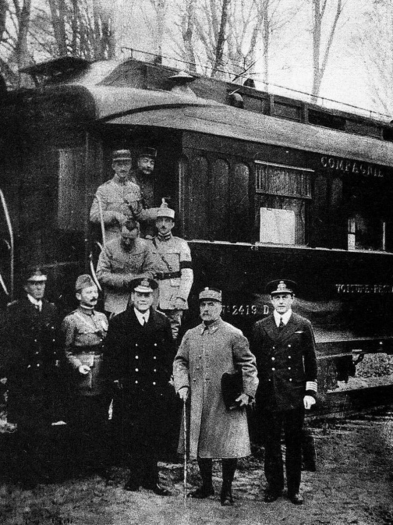
Nov. 8th, 1918 members of the French and German commands met in a railway car outside Paris to sign a cease fire.

Slide 5
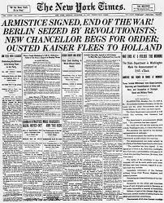
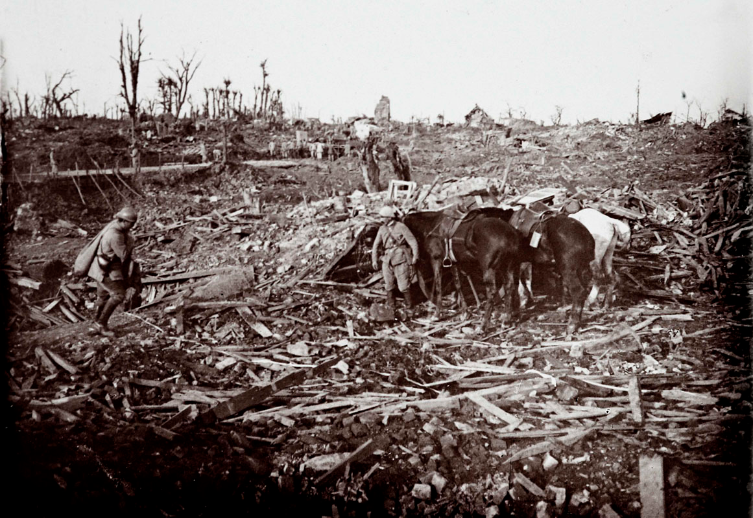
End of War
Germany does not surrender. They agreed to an armistice based on Wilson’s 14 Points which argued for “peace without victory”
Armistice: an agreement made by opposing sides in a war to stop fighting for a certain time; a truce to conduct peace talks
But Allies do not follow Wilson’s plans- resent U.S. moral superiority since they did not pay the full price of war compared to Europe.

Slide 6
Wilson’s 14 Points
Wilson’s plan for a post-war world
Turned WWI, an imperialist war, into a war of self-determination
Define self-determination
Read Wilson’s 14 Points
What were some of Wilson’s suggestions and how would they help prevent future wars?

Slide 7
Wilson’s 14 Points
Vision of a world where domination of others and war would be replaced with cooperation and negotiation. Some of the highlights of his plan included:
Limiting the number of weapons a country could have
Providing for human rights for colonial subjects
Abolishing secret treaties
Redrawing the map of based on ethnic boundaries. (to solve the Balkans problem that caused the war)
Absolute freedom to navigate the seas and trade freely.
Establishment of a League of Nations.

Slide 8
Problems?
When U.S. joined the war ignored the secret treaties already in effect (Treaty of London)
France had suffered the most and wanted revenge
Nearly all of the fighting along the Western Front was on French soil.
90% of French young men had been called off to war–75% of them wouldn’t come back.
Returning soldiers were missing arms and legs.
Many of its villages and towns lay in ruins.

Slide 9
Cost of War
More than 17 million military and civilian deaths
More than 20 million wounded and handicapped for life
Famine threatened many regions
Financial burden of reconstruction of almost all of Europe – war debts
4 Empires destroyed: governments in Russia, Austria-Hungary, Germany, and the Ottoman empire had collapsed
Victors would redraw the boundaries of the world (poorly) and sow the seeds for the majority of the conflicts of the 20th century.
Fascists and Communist movements would arise across Europe and within 18 years rule most of the continent
Colonies saw that Europe was weak and were ready to fight for independence

Slide 16
Cause developments in Plastic Surgery- reconstructed faces w/ prosthetics

Slide 18
Paris Peace Conference
David Lloyd George (Britain), Vittorio Orlando (Italy), Georges Clemenceau (France), and Woodrow Wilson (US) (left to right) Germany and Russia not invited to attend

Slide 19
WILSON:
Spoke of democracy and self-determination – became a symbol of hope
The establishment of the League of Nations was Wilson's most important goal at the peace conference- sacrificed other goals to get it.
GEORGE & CLEMENCEAU:
One goal for postwar peace shared by the British and French leaders was to weaken Germany and make it pay for the war.
But Britain still want Germany to be a strong enough presence to block Russian Communism spreading to rest of Europe.
OTHERS:
Italy had signed a secret treaty with the Allies during the war and wanted Italian lands once ruled by Austria-Hungary (contradiction to Wilson’s principle of self-determination)
Colonies who had been ruled by Russia, Austria-Hungary, or the Ottomans Empire demanded national states of their own but the territories claimed by these people often overlapped so it was impossible to satisfy everyone.

Slide 20
Paris Peace Talks
Britain and France (David Lloyd George and Georges Clemenceau) promised their nation justice and preventing future aggression from Germany.
President Wilson wanted “peace without victory,” 14 points for peace.
Right to Self-determination for European countries:
This did not apply to non-European countries.
Britain and France divided up Germany’s African colonies.
Britain and France divided up the Ottoman Empire.
The Ottoman Empire is dissolved and a new republic of Turkey is created.

Slide 22
Treaty of Versailles
In exchange for peace Germany would:
Return Alsace-Lorraine to France and give up control of coal-rich Rhineland- to be occupied by Allies for 15 years .
gave up its entire air force, most of its navy and its army was limited to 100,000 men.
Forbidden to join League of Nations
Alliance with Austria forbidden
Loss of overseas colonies- split between France and Great Britain

Slide 23
Treaty of Versailles
accept 100% of the blame for causing the war and thus pay the entire cost of the war (Article 231: War Guilt Clause)
Most humiliating and detrimental of all Germany would have to pay reparations for the entire cost of war–132 billion marks (or $768 billion in today’s money)– on its own, while trying to rebuild its own shattered economy.
Germany would finish paying off its war debt in 2010- 93 years later

Slide 26
Treaty of Versailles
June 1919 – Germans ordered to sign Treaty of Versailles against their will.
The Germans resented the terms of the Treaty of Versailles
Problem: German government that signed the treaty NOT the same government that declared war.
News of treaty helped cause civil war in Germany, overthrowing the moderate government and fuel social and economic discontent that leads to the rise of Nazism and Hitler.

Slide 28
Germany’s Humiliation
German ministers sign the treaty in the Hall of Mirrors at Versailles, the same spot the Kaiser's grandfather had been proclaimed emperor of the German Empire (2nd Reich) in 1871 after defeating France in the Franco-Prussian War.

Slide 29
"The day must come when a German government shall summon up the courage to declare to the foreign powers: 'The Treaty of Versailles is founded on a monstrous lie. We fulfill nothing more. Do what you will! If you want battle, look for it! Then we shall see whether you can turn 70 million Germans into serfs and slaves!”
-Adolph Hitler, 1923

Slide 30
League of Nations
In exchange for harsh punishments on Germany, European nations agree to form Wilson’s League of Nations
Formed to keep peace in the world – agreed to negotiate rather than resort to war; promised to take common action, economic or military, against any aggressor state.
More than 40 nations joined but the US Senate refused to ratify the treaty and the US never joined the League (ironic b/c it was President Wilson’s creation and dream)
However the League was powerless to prevent aggression or war – hence WWII!

Slide 31
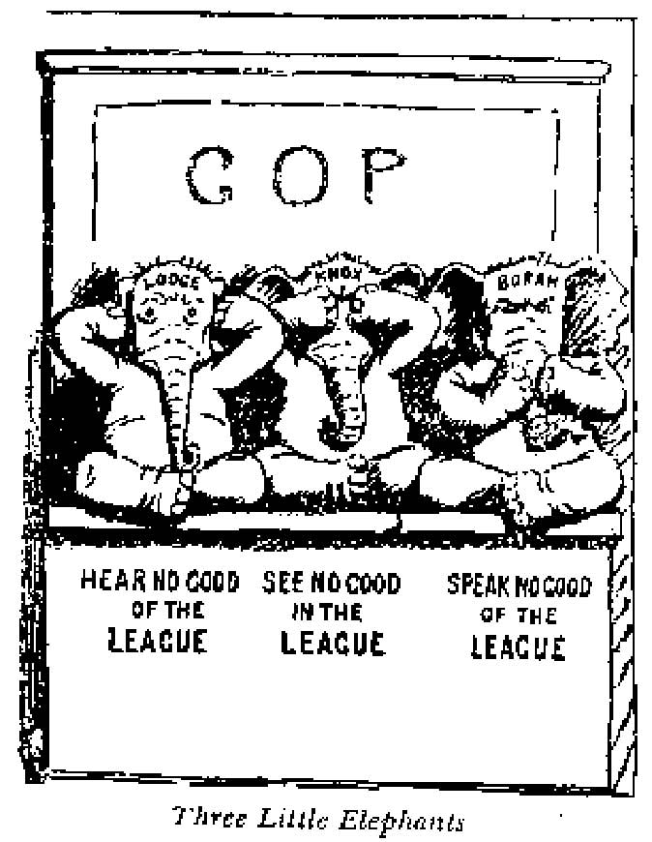
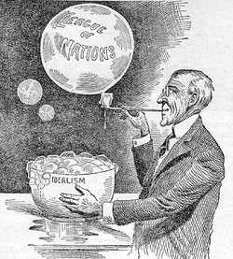

Slide 33
U.S. Failure to Join L. of N.
Midterm Election of 1918: Wilson campaign as a democratic president
Divided government: Republican majority in Congress
Wilson didn’t take one ranking Republican to Paris Peace Talks
Henry Cabot Lodge- chairman of Foreign Relations Committee and hated Wilson
American public against: believed league would involve America in many European wars (revert to isolationism after war)
Thought President or L. of N. alone could declare war bypassing Congress- unconstitutional
German-Americans mad at Versailles Treaty- see Germany’s punishments as unfair
Wilson’s bad health- strokes

Slide 34
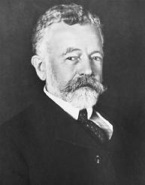

Slide 35
Problems: Wilson
Wilson refuse to compromise or negotiate any parts of the treaty with Congress
Instead goes on a speech tour to rouse public support for the treaty
Argued treaty included a “moral, not a legal, obligation,” that congress would still reserve the right to decide to go to war
Wilson suffer a stroke- partially paralyzed for two months
Once recovered even more unwilling to compromise, and the Senate couldn’t get the needed majority to pass either Wilson’s or Lodge’s treaties
U.S. sign separate peace with Germany in 1921 after Wilson is no longer president

Slide 37
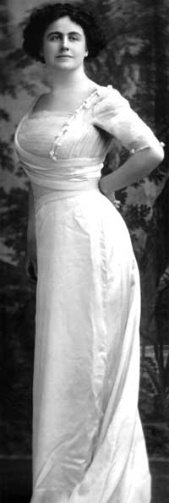
Edith Wilson: 1st Woman President?

