Slide 1
Sunnyside Unified School District
The Academies at Sunnyside….
Responding to the Need for College and Career Ready Graduates and Community Transformation
May 14, 2013

Slide 2
Growing Opportunities For Our Students:
“The nation’s 5th Largest Aerospace-defense industry cluster accounts for 50,000 jobs in Southern Arizona, including a concentration of the highest-paid jobs,…”
“The region’s strategic location along the U.S.-Mexico border and key trade routes account for the prominence of transportation and logistics with career opportunities in purchasing, expediting, distribution, fleet management, import-export, supply chain management and warehousing.”
-Pima County Workforce Investment Board, 2012 Annual Report.
“…By 2018, Health Science careers will be the fastest growing in Arizona at 29% over the next eight years.”
“In Arizona, jobs for those with a post-secondary education will grow much more rapidly than for those that don’t. By 2018, over 1.9 million jobs will be available in Arizona for those with a post-secondary education.”
-Career Clusters, Forecasting Demand for High School Through College Jobs 2008-2018, Georgetown University Center on Education and the Workforce, November 2011.
Notes:
Steve H

Slide 3
The Academies at SUSD
The Academies at Desert View High School
Aerospace i-STEM and Digital Technology
International Hospitality, Tourism and Culinary Arts
The Academies at Sunnyside High School
International Business and Information Technology
Transportation Technology and Logistics
Sunnyside Online Success Academy
Visual and Performing Arts
Law, Public Safety, Security and Human Services
Medical and Allied Health Sciences
Sunnyside Freshman Academy
Desert View Freshman Academy
Notes:
Steve H

Slide 4
The Academies at SUSD-Connected Learning
Career
Academy
Focus Area
English
Math
Social Studies
Science
Anywhere, Anytime, Online Learning
Digital Learning & One to One Computing
Internships & Community
Partnerships
Industry Credentials and/or Certificates
Economic Development & Community
Transformation
Dual College Credit Opportunities
Global Classes
Support Services
Common Core
Common Core
Athletics
Fine Arts
Notes:
Jose

Slide 5
By Year Three of The Academies at SUSD, Our Goal is That 100% of Our Students Will Have The Opportunity to Experience…
Online Classes, Anywhere-Anytime
Industry-Recognized Credentials and Certificates
Internships
Dual Academic and College Credit
International Partnerships for Global Perspectives
Notes:
Jose

Slide 6
The Academies at SUSD-Guiding Principles Based on Rigorous Program of Study Pathways:
Collaborative
Partnerships
Dual Academic and College Credit
Systemic
All High School Students Enrolled in an Academy
Course Sequences
Student-Centered
Broad Academy Clusters Offering Multiple Choices of Program Focus Pathways Offering High Wage and High Opportunities for Future Employment
Anywhere-Anytime Online and Blended Learning Options
Professional Development
Internships, Service Learning, Job Shadowing and School-Based Enterprises
Industry Credentials and/or Certifications
Accountability and Evaluation Systems
College and Career Readiness Standards (Common Core)
Credit Transfer Agreements
Technical Skill Assessments
Guidance Counseling and Academic Advisement
Teaching and Learning Strategies Focused on Student Development
PARCC (Partnership for Assessments of College and Career Readiness) Assessments
“Early College” Options for Students to Earn AA Degree
Adapted, POS Design Framework, OVAE, U.S. Department of Education, 2010
Notes:
Kathy

Slide 7
The Academies at SUSD
A Commitment to College and Career Readiness
A Model For Innovative Digital Learning
Partnerships For Community Transformation
Notes:
Kathy

Slide 8
Partnerships For Community Transformation Include:
City of Tucson-
Grad Link Project
Tucson Hispanic Chamber of Commerce-Entrepreneurship Curriculum and Certification Project
Neighborhood Aerospace Business Corridor
University of Arizona Research Parks Internship Project
Pima County One Stop Centers Precision Manufacturing Internship Focus Groups
Southern Arizona Logistics Education Organization (SALEO) Curriculum Development
University of Arizona College of Medicine-Project HOPE Medical Careers Project
Metropolitan Education Commission Regional College Access Center
University of Arizona Bio5 Internship & Support Projects
Notes:
Kathy-We have a number of existing partnerships that provide enhanced experiences including internships for our students with the promise of community transformation and these will only expand with the launch of the Academies. This is just a sampling of a few and a goal might be for some of our academies to have branded sponsorships as we have seen in other areas of the country such as the “Sony Academy of Music Production” in Nashville.

Slide 9
The Academies at Desert View High School
Aerospace i-STEM and Digital Technology
Engineering Sciences (U of A Engineering 102)
Culinary Arts
International Hospitality, Tourism & Culinary Arts
Visual and Performing Arts
Technical Theater
Communications Media Technologies (Photo, Yearbook, Video, Web Design, Game Design & Animation)
Aviation & Military Science (AFJROTC)
Fashion Design & Merchandising
Business Operations and Support Services
Agri-Business-Plant Science (Hydroponics/Organic Foods)
Sports Medicine
Hospitality/Tourism
Drafting & Design (Mechanical 3-D)
Precision Manufacturing
Information Technology-Computer Hardware Repair
Notes:
Michael and Mae

Slide 10
Aerospace i*-STEM at Desert View *innovative
Precision Manufacturing-NIMS CNC Operator Certification
Drafting and Design-3-D Design-SolidWorks Software
Engineering Sciences-U of A College of Engineering Credit, Apple App Development, Robotics Programming
Information Technology-HP Computer Repair Certification
Sports Medicine-Athletic Training
Notes:
Michael and Mae

Slide 11
The Academies at Sunnyside High School
Medical and Allied Health Sciences Careers
Nursing Services
BioTechnology-U of A Molecular Cellular Biology 102, 102
Law, Public Safety, Security & Human Services Careers
Law, Public Safety & Security
Sports Medicine
Early Childhood Education
Auto Body Collision Technology
Automotive Technology (Fleet , Alt. Fuels)
Transportation Technology & Logistics
International Business & Information Technology
Business Management and Administrative Services
Communications Media Technologies (Photo, Yearbook, Video, Animation, Web Design)
Marketing/Entrepreneurship
Education Professions (Proposed for future expansion-students intern at after-school programs
Information Technology-Computer Repair
Notes:
Ana and Josh

Slide 12
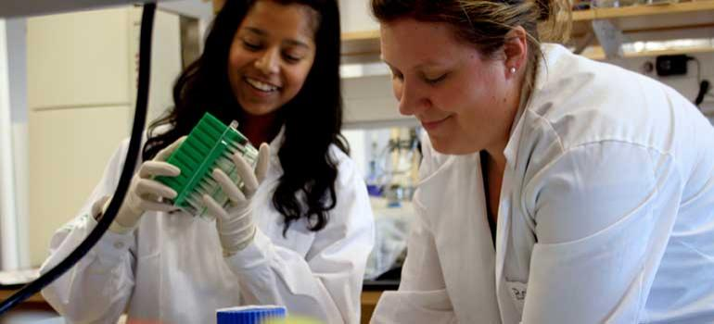
Medical and Allied Health Sciences at Sunnyside High School
Nursing Services-Certified Nursing Assistant Program-AZ State Board of Nursing
BioTechnology-U of A Molecular Cellular Biology Dual Credit in MCB 102, 102 and Kino Heritage Trees Project with U of A and AZ Sonora Desert Museum Researchers
Sports Medicine-Assist Athletic Trainers
Notes:
Ana and Josh

Slide 13
A Model For Innovative Digital Learning
Project Graduation-SUSD Digital Advantage
SUSD One to One Initiative
Freshman Interventions
Freshman Academy
Traditional Credit Recovery
Sunnyside Online Success Academy Classes
Traditional Advisory and Graduation Plans
Advisory With Rigor, Relevance and Relationships and Early College and Career Plans
AVID Delivered as a Program
AVID Embedded Across the Academics
Notes:
Steve Y

Slide 14
Scheduling to Facilitate Professional Development and Flexible Student Service Time
Proposed Bell Schedules for Modified Block 2013-2014
Monday, Thursday, Friday stay the same as current upper school schedule
Block days must follow one another
Collaboration time would be designated for professional development and/or collaboration by department or team
7:20 – 7:50 | ECAP |  | 7:20 – 7:50 | ECAP |  | 7:20 – 7:50 | ECAP
7:55 – 9:30 | 1 |  | 7:55 – 9:30 | 1 |  | 7:55 – 9:30 | 1
9:30 – 10:00 | Lunch |  | 9:35 – 11:10 | 3 |  | 9:35 – 1020 | 3A
 |  |  |  |  |  | 10:20 – 10:50 | Lunch
10:05 – 11:40 | 3 |  | 11:10 – 11:40 | Lunch |  | 10:55 – 11:40 | 3B
11:45 – 1:20 | 5 |  | 11:45 – 1:20 | 5 |  | 11:45 – 1:20 | 5
Tuesday (1,3,5)
95 minute classes
30 minute ECCAPP
80 minutes of
collaboration
9:30 – 11:05 | 2 |  | 9:30 – 11:05 | 2 |  | 9:30 – 11:05 | 2
11:10 – 12:45 | 4 |  | 11:05-11:35 | Lunch |  | 11:10 – 11:50 | 4A
 |  |  |  |  |  | 11:50 – 12:20 | Lunch
12:45 – 1:15 | Lunch |  | 11:40 -1:15 | 4 |  | 12:25 – 1:15 | 4B
1:20 – 2:55 | 6 |  | 1:20 – 2:55 | 6 |  | 1:20 – 2:55 | 6
Wednesday (2, 4, 6)
95 minute classes
120 minutes of collaboration
Notes:
Steve Ybarra

Slide 15
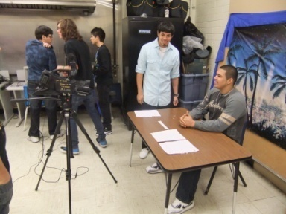
Commitment to College and Career Readiness
Notes:
NJ

Slide 16
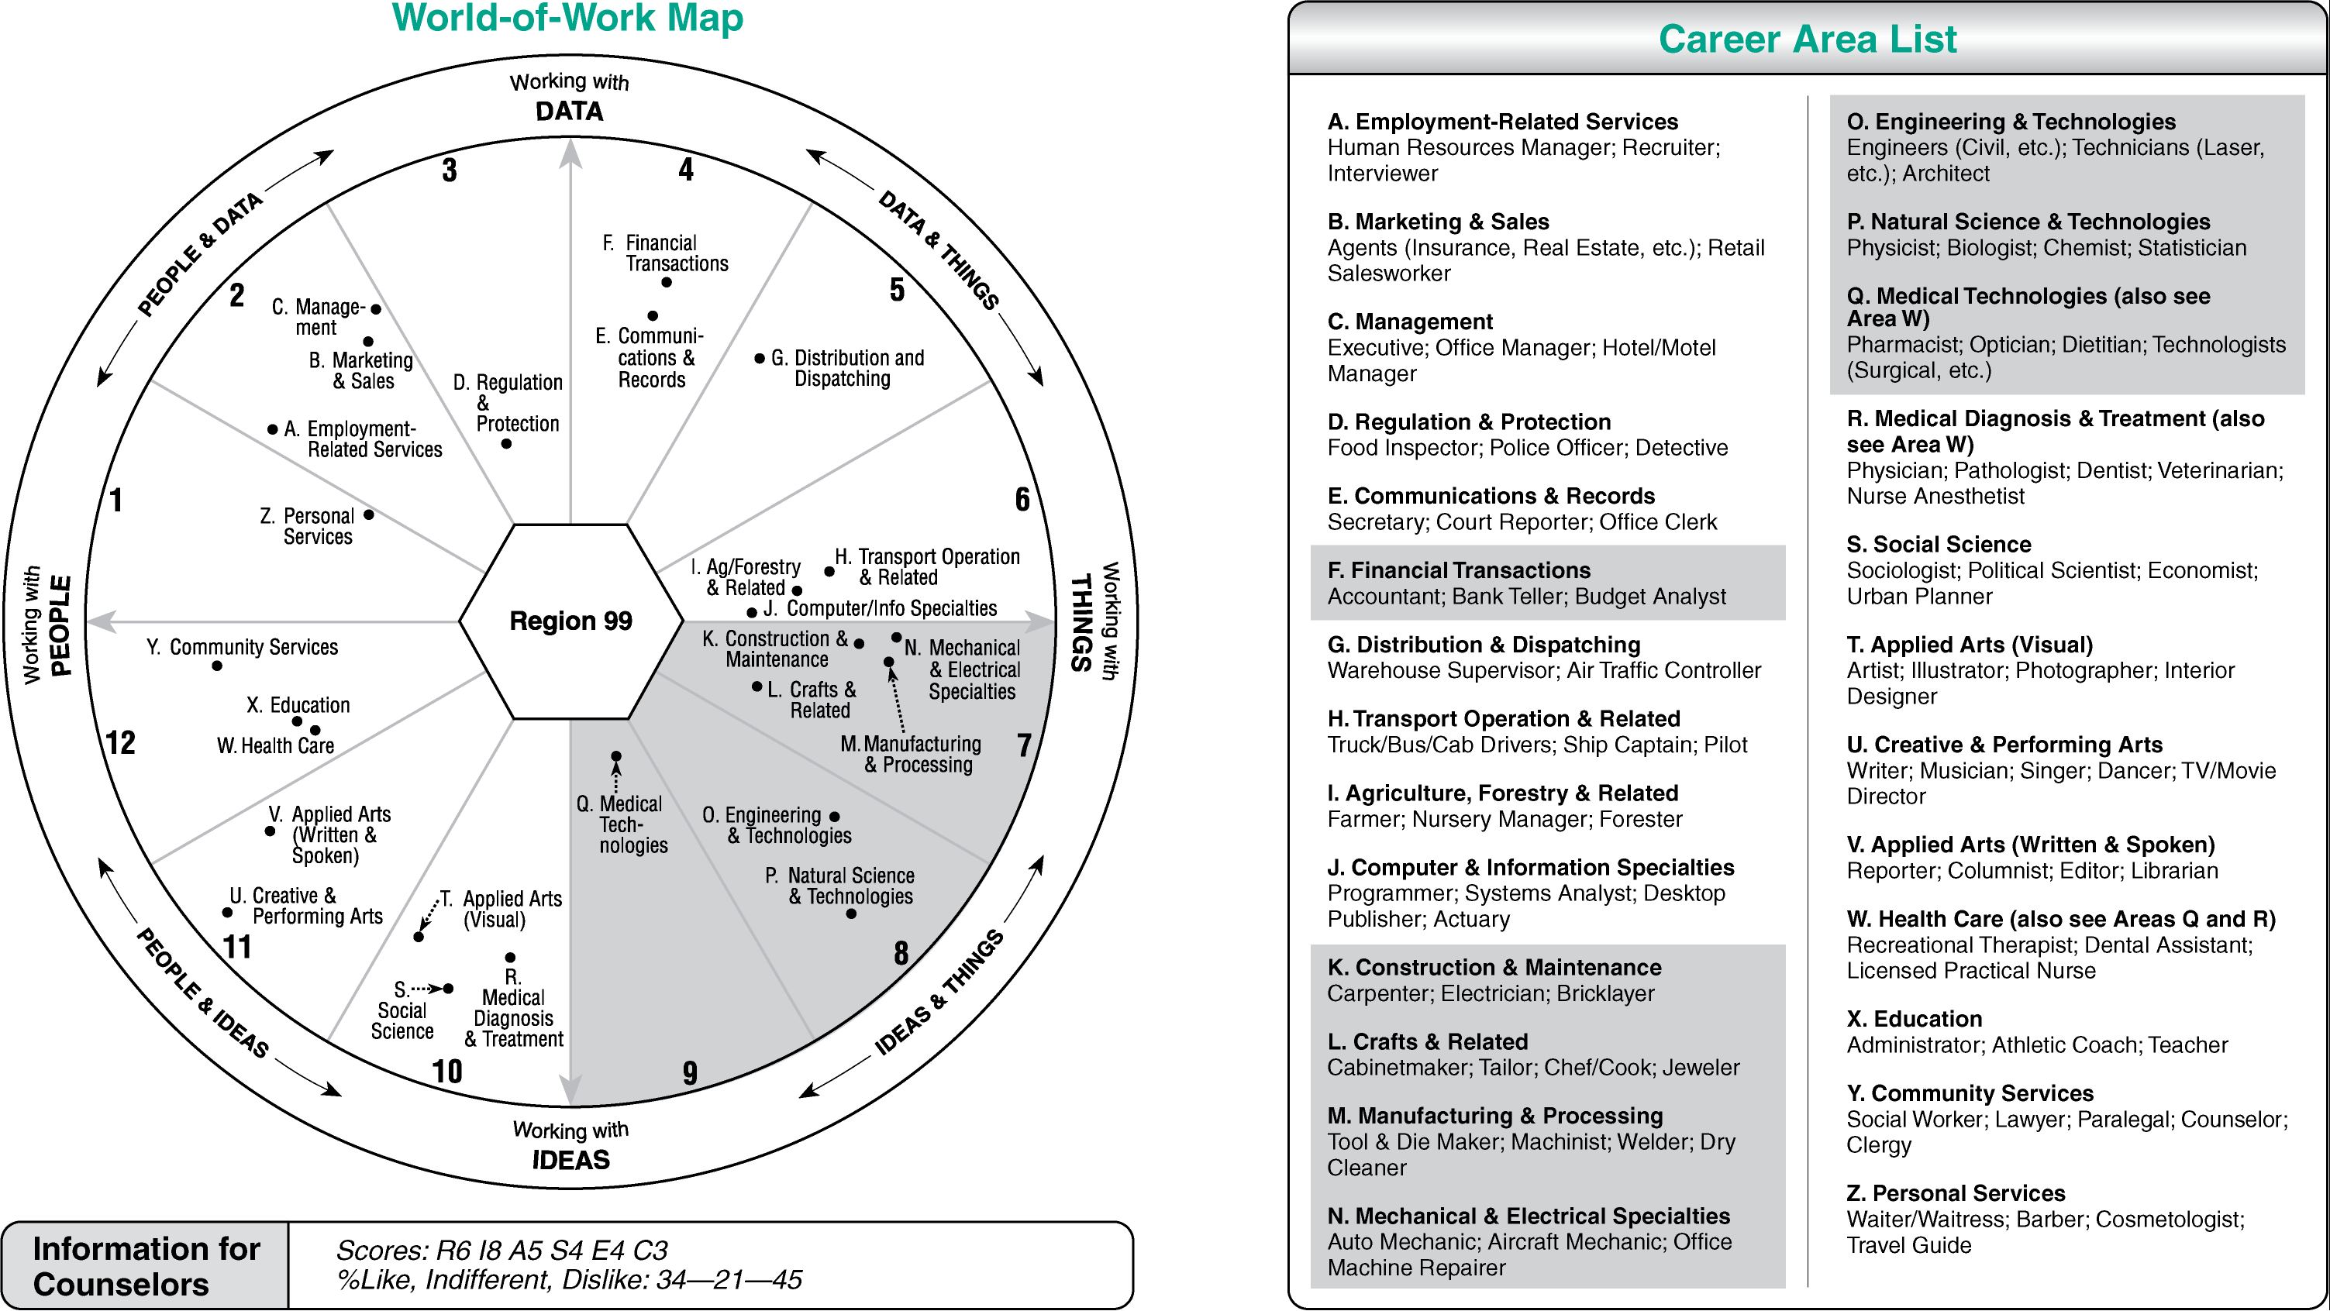
EXPLORE and PLAN Data
13
9/2010
Notes:
NJ

Slide 17
Four Steps to College and Career Plans
Notes:
NJ
Dream big
Plan, beginning in high school, so you take the right classes to get to college.
Work hard – give your studies 100%- always do your best.
Track – page 6 and 7 will help you check off the things that you do in each grade to be prepared.
Another important thing to do in high school is get involved in extracurricular activities (after school sports and clubs) and volunteer in the community. Many colleges want to see that you were involved in other activities while doing your best in your classes.
Tip – Ask students if they want to be living at home when they are 25. Explain that if they want to have a job and make enough money to have their own place – they need to start thinking now about what their plan is and working on it.

Slide 18
Three-Year Plan:
2013-2014 Year 1
Freshman Academy
-Continued 1:1
Revised Bell Schedule
Sophomore Academy --New 1:1
Grades 11-12 English Language Arts Academy Projects (New)
2014-2015 Year 2
Freshman Academy
Grades 10-12 College and Career Academy Projects English Language Arts and Math (New)
11th, 12th grade
--New 1:1
2015-2016 Year 3
Freshman Academy
Grades 10-12 College and Career Academy Projects English Language Arts, Math and all other content areas (New)
Capstone Projects -12th Grade (New)
Key:
Continuing Items =
New Items =
Notes:
Steve H

