Slide 1
Apollo Middle School
“Soaring Above the Rest”

Slide 2
Apollo Clubs and Activities
STUDENT COUNCIL
GLEE CLUB
AVID
YES (Youth Empowered for Success)
CHEER CLUB
JUNIOR LITERACY COUNCIL
WEIGHT-LIFTING CLUB
NATIONAL JUNIOR HONORS SOCIETY
APOLLO CONGRESS

Slide 3
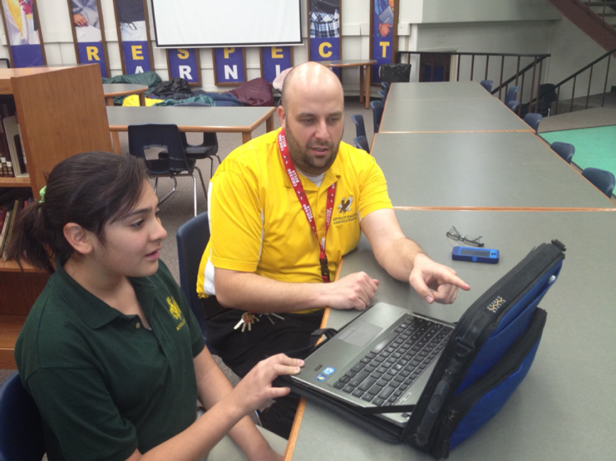
Apollo Tutoring
University of Arizona Tutors
Tutoring for all grades & content
LEADS Tutoring
For specific help in Math or Reading
Tutoring with Teachers
By appointment
Teacher Office Hours on Posted schedule

Slide 4
Apollo Athletics
Season 1 Sports
Flag Football
Volleyball
Cross Country
Season 2 Sports
Boys Basketball
Girls Soccer
Season 3 Sports
Boys Soccer
Girls Basketball
Wrestling
Season 4 Sports
Baseball
Softball
Track/Field

Slide 5
School to School Transition 2014 – 2015
Sierra
To
Apollo!

Slide 6
Parent/Administration Meeting
Sierra M.S.
March 18, 2014
5:00 PM
Welcome to all Students and Families coming to Apollo M.S. in the 2014-2015 School Year!

Slide 7
Presentation to Current Apollo Students
Student Relations Team presentations/talks with
current 6th and 7th grade students
March and April
ECAPP Classes

Slide 8
Campus Tours and Team Building
Apollo Campus Tours for Sierra Students at Apollo
Coming in May…

Slide 9
Meet your Administrator Night
Open for students and their families
Guided Tours by student leaders
Monday May 12th at 5:00 PM

Slide 10
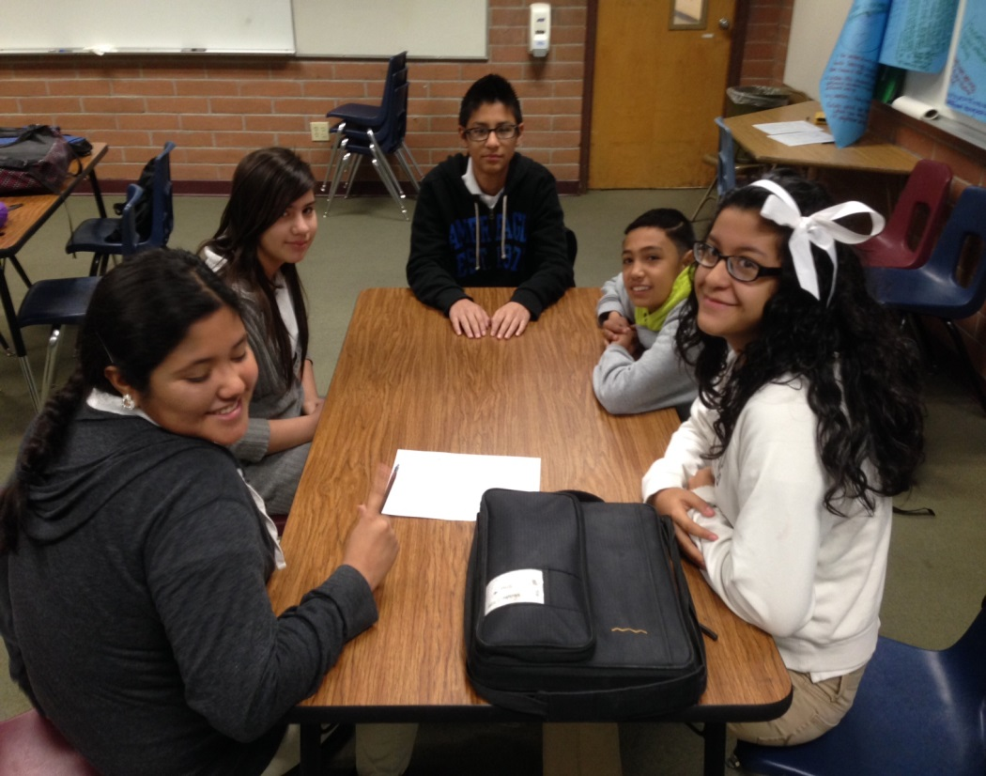
Student Helpers
Student Leaders will be in the hallways during passing periods to guide students to their classes.
Virtual Tours are posted online too!

Slide 11
School Uniforms
White or Forrest Green Collared Polo type shirts
Khaki/Tan/Beige colored shorts, pants, or capri pants

Slide 12
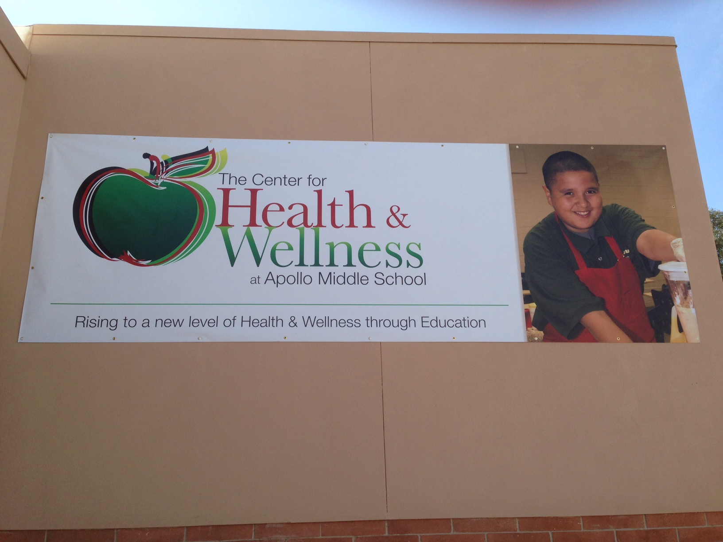
Apollo Center for Health and Wellness

Slide 13
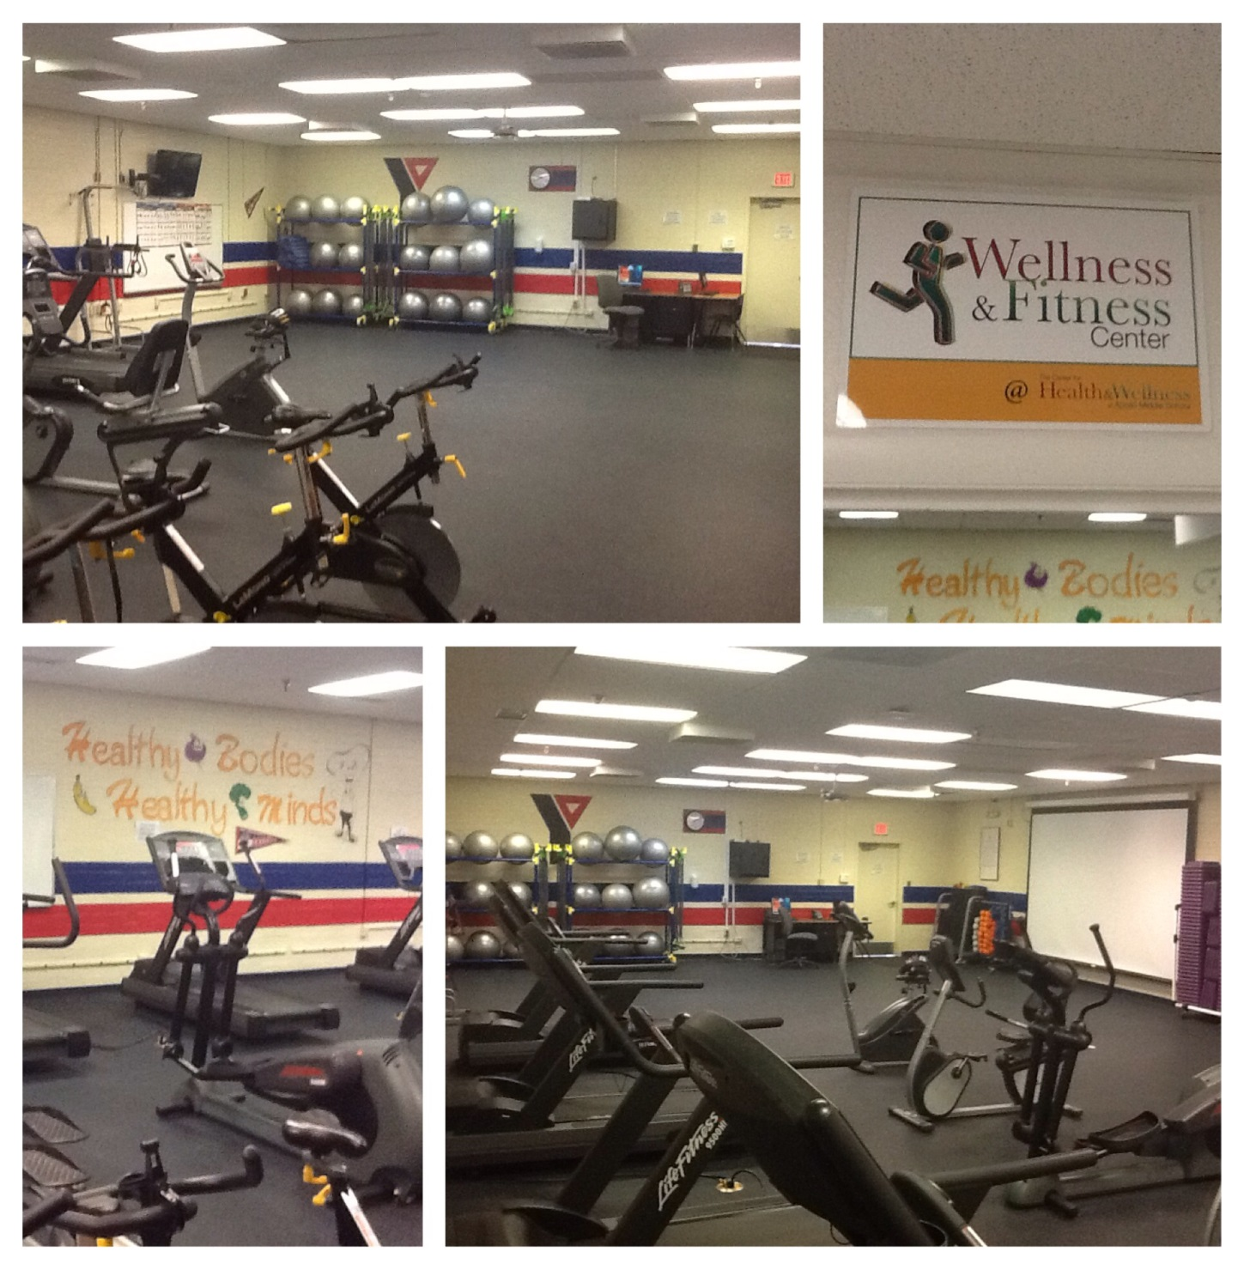
Wellness and Fitness Center

Slide 14
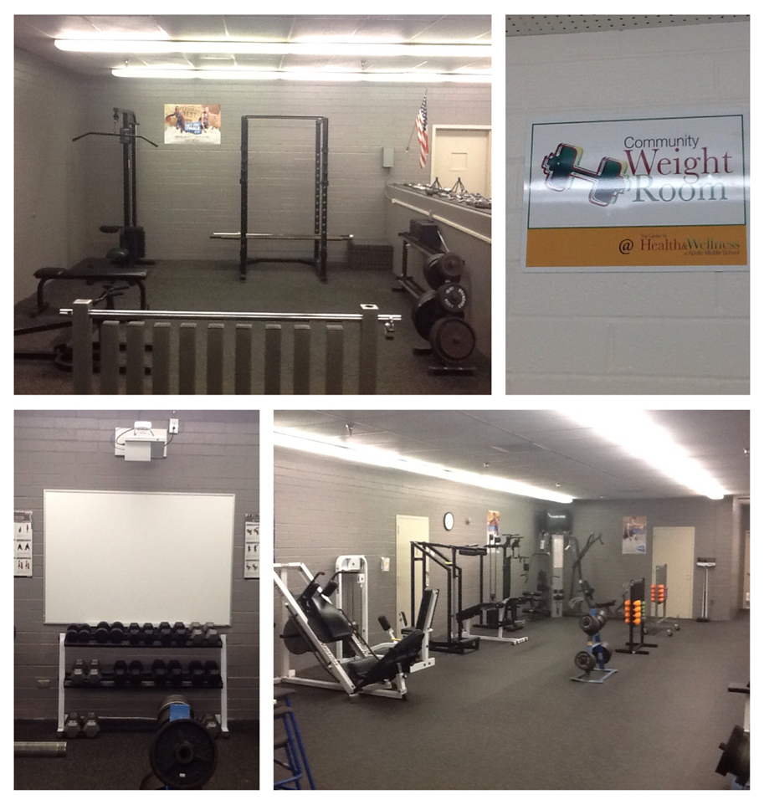
Community Weight Room

Slide 15
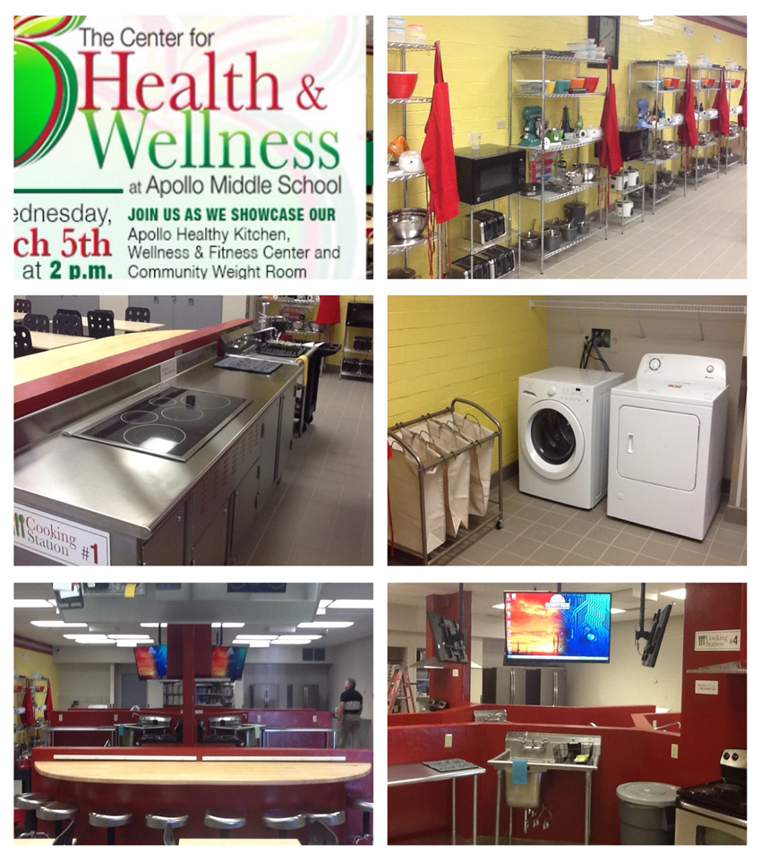
Apollo Healthy Kitchen

