Slide 1
Vocabulary
February 2-6

Slide 2
editorial
Definition: an essay in a newspaper or magazine that gives the opinions of its editors or publishers.
Part of Speech: noun

Slide 3
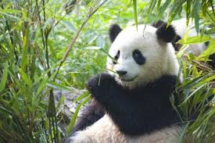
editorial
The editorial in the newspaper was on a Giant Panda.

Slide 4
opinion
Definition: what someone thinks about a particular thing.
Part of Speech: noun
Synonyms: belief, judgment, feeling

Slide 5
opinion
The fourth
Graders wrote an opinion on dress code.

Slide 6
gist
Definition: the main point or part of a text (usually 20 words or less)
Part of Speech: noun
Synonyms: sum, point

Slide 7
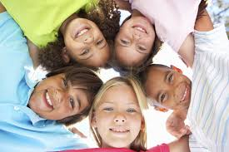
gist
The
students understood the gist of the reading lesson.

Slide 8
reason
Definition: a statement or fact that explains why something is the way it is, why someone does, thinks, or says something, or why someone behaves a certain way. Part of Speech: noun
Synonyms: explanation, rationale

Slide 9
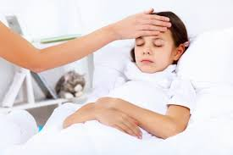
reason
The reason Stephanie missed two days of school was because she had the flu.

Slide 10
summarize
Definition: to tell (information) again using fewer words.
Part of Speech: verb
Synonyms: recap, sum up

Slide 11
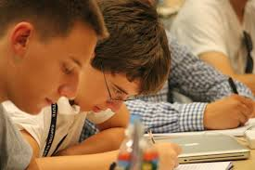
summarize
After the lesson, the boys had to summarize what they learned.

Slide 12
observation
Definition: something you notice by watching and listening.
Part of Speech: verb
Synonyms: notice

Slide 13
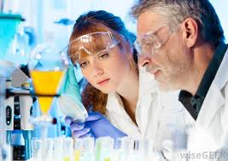
observation
The scientists observation of the experiment was vital for the data.

Slide 14
collaboration
Definition: to work with another person or group in order to achieve or do something
Part of Speech: verb
Synonyms: cooperation, communicate

Slide 15
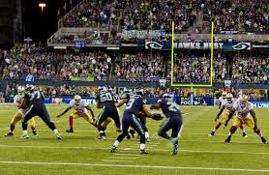
collaborate
After the win, the players collaborate on their success.

