Slide 1
Supreme Court Cases One Slide Wonders
Objectives of the Slide
It must have a summary of court facts
It must have visuals
It must have a Primary source.
It must include case ruling and relevant impacts on US Law.
Students will research one Supreme Court Landmark case and create and one PP slide.

Slide 2
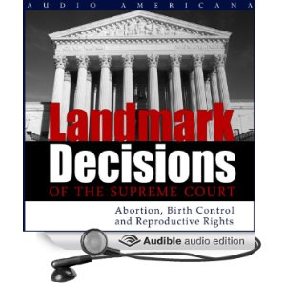
Next Slide is an example.
Assignment must include:
Case summary
Ruling of the court
Include impact on society, and US Law.
Primary source quote

Slide 3
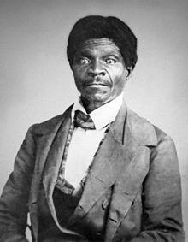
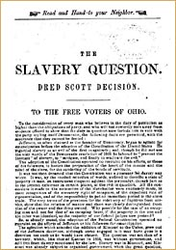
Dred Scott v. Sandford, 1857
Case: Dred Scott, a slave moved from a Slave state to a Free State. He sued to become free. He lost.
Ruling: "The Constitution does not consider slaves to be U.S. citizens. Rather, they are constitutionally protected property of their masters.”
Results: The country became more divided and the Civil War became unavoidable.
"beings of an inferior order, and altogether unfit to associate with the white race, either in social or political relations, and so far inferior that they had no rights which the white man was bound to respect.“
---Chief Justice Taney (for the majority):

